Slide 1
A very simple recurrent neural network's capabilities of reconstructing global temperature anomalies.

Slide 2
Data
20CRv3 (1851-2015 as training, 1836-1850 as test)
CSM-LME (851-2005 x 14)
MPI-GE (1851-2005 x 100)
EKF400v2 ens mean
ISTI temperature stations (select 25 early, long term stations)
We going to work with anomalies wrt 1951–1981

Slide 3
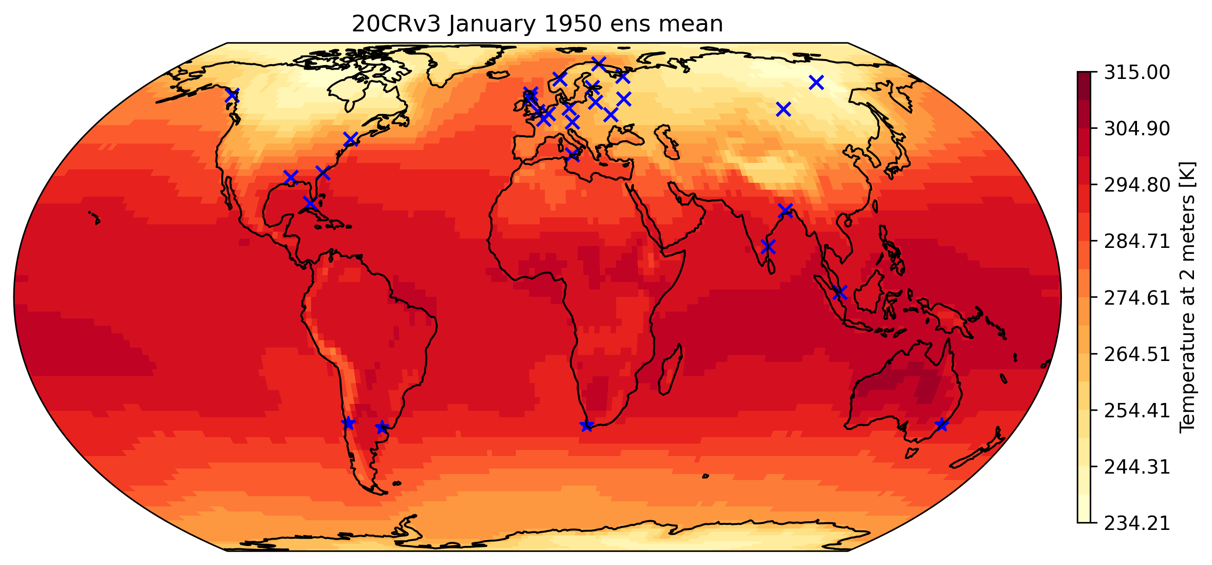

Slide 4
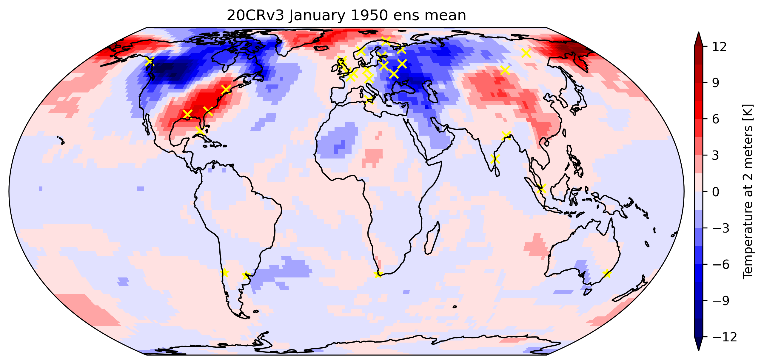

Slide 5
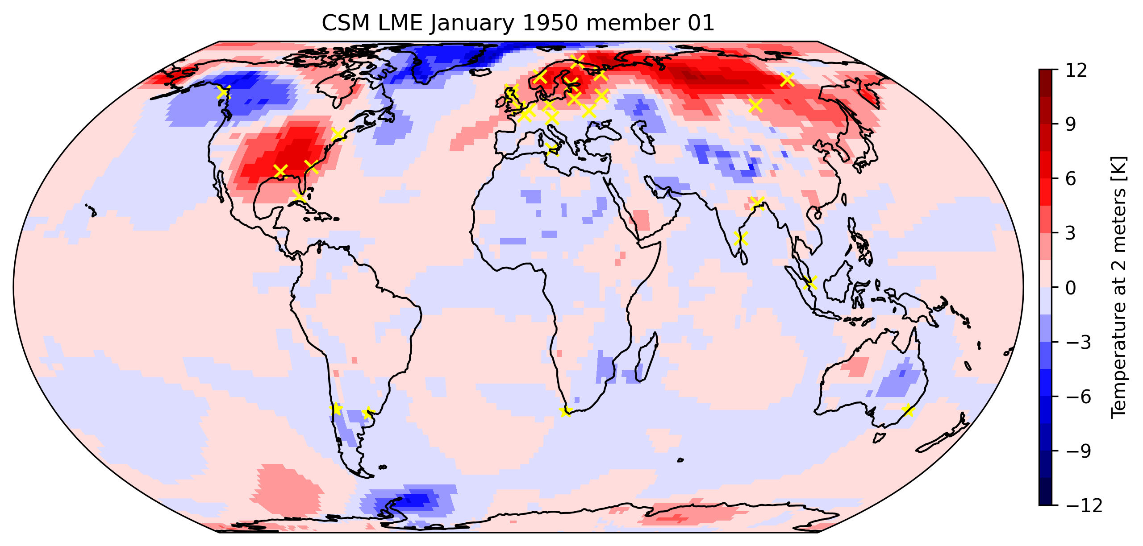
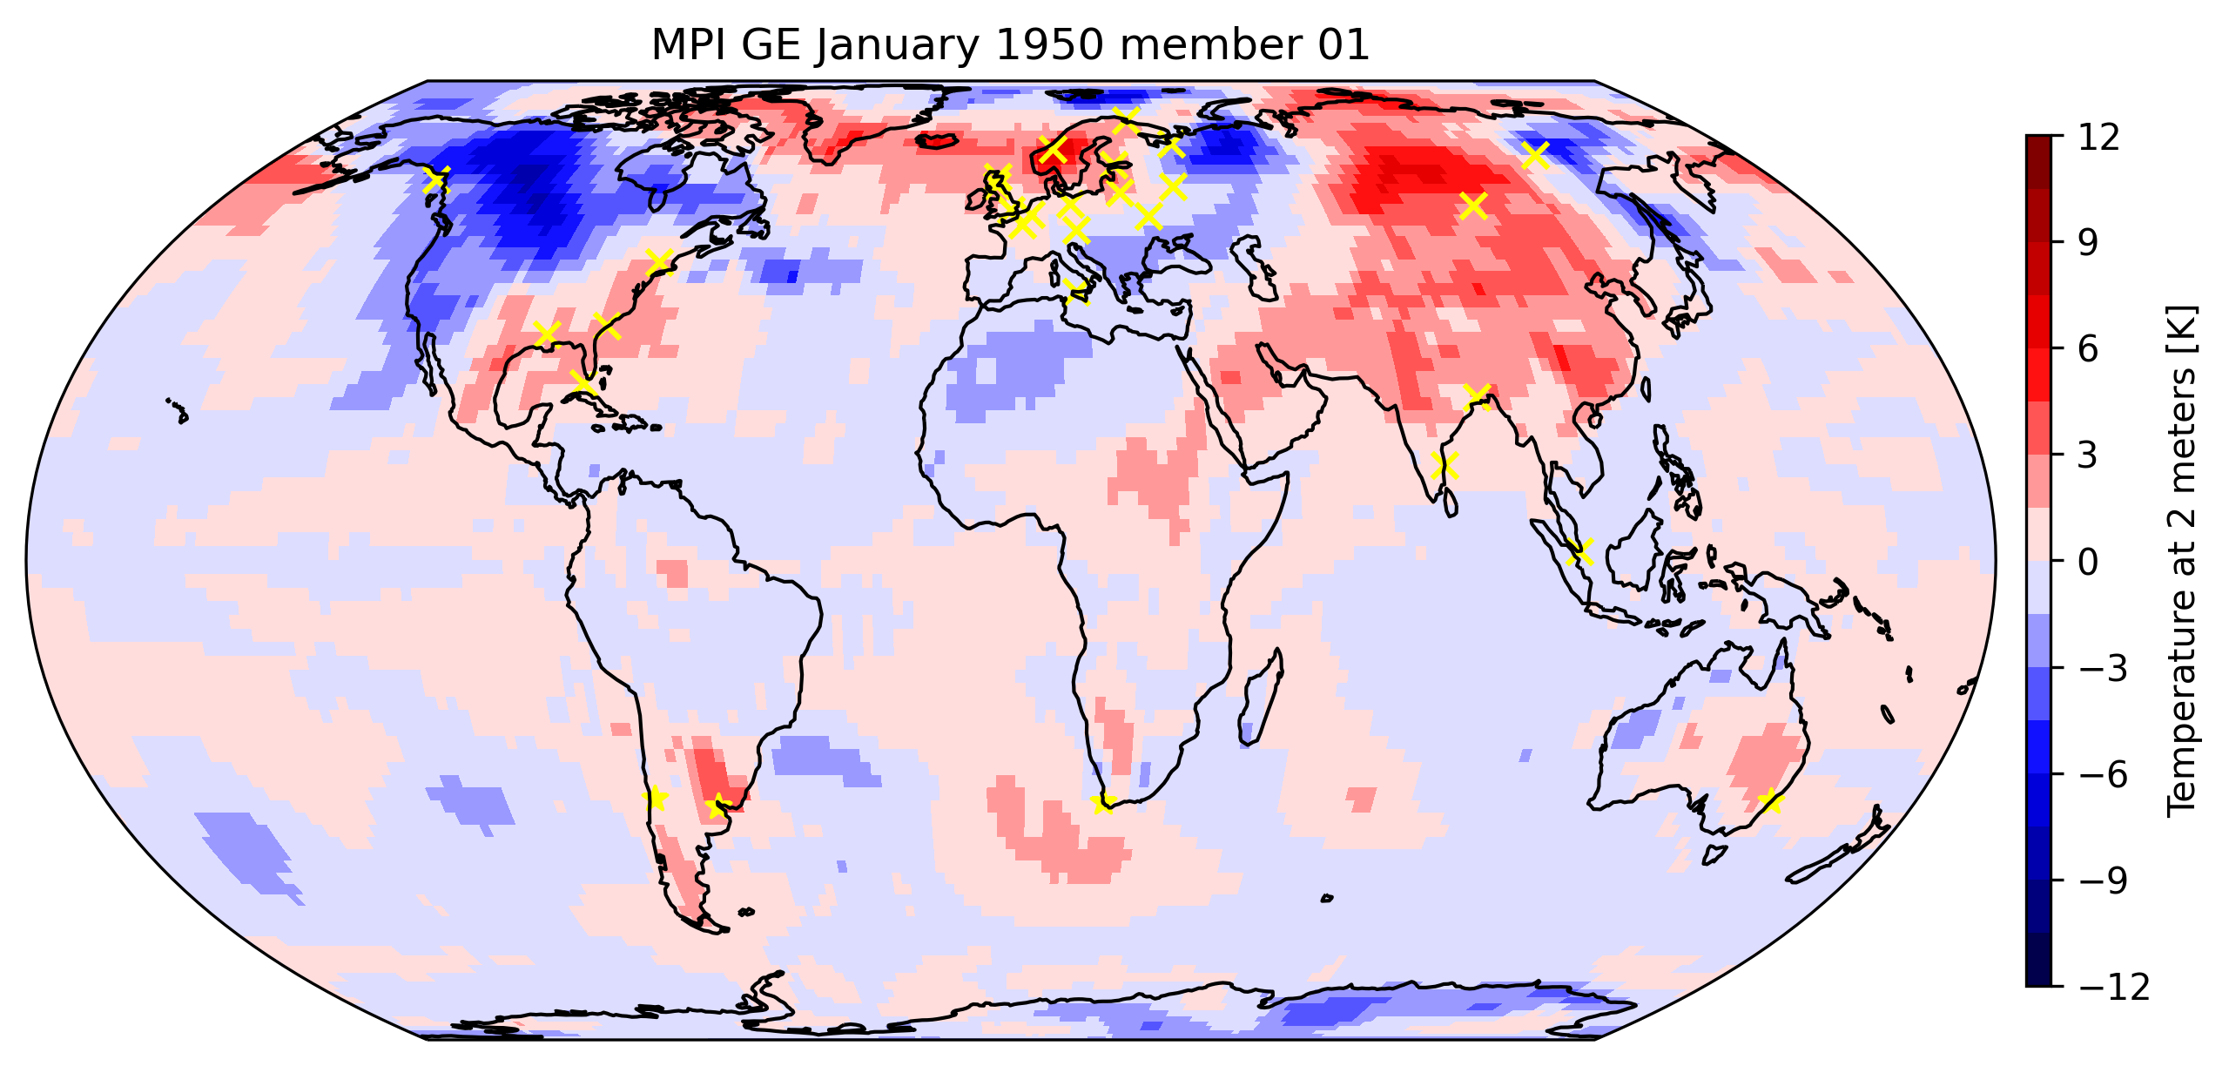
N=1980 (1851-2015)
N=180024
N=187200

Slide 6
Methods
25 points reconstruct 18432 points
Randomize 1979 or 20000 months as input
Create an ensemble of 5 reconstructions
Comparison with 4824 months of EKF400v2 ens mean
Comparison with 168 months of 20CRv3

Slide 7
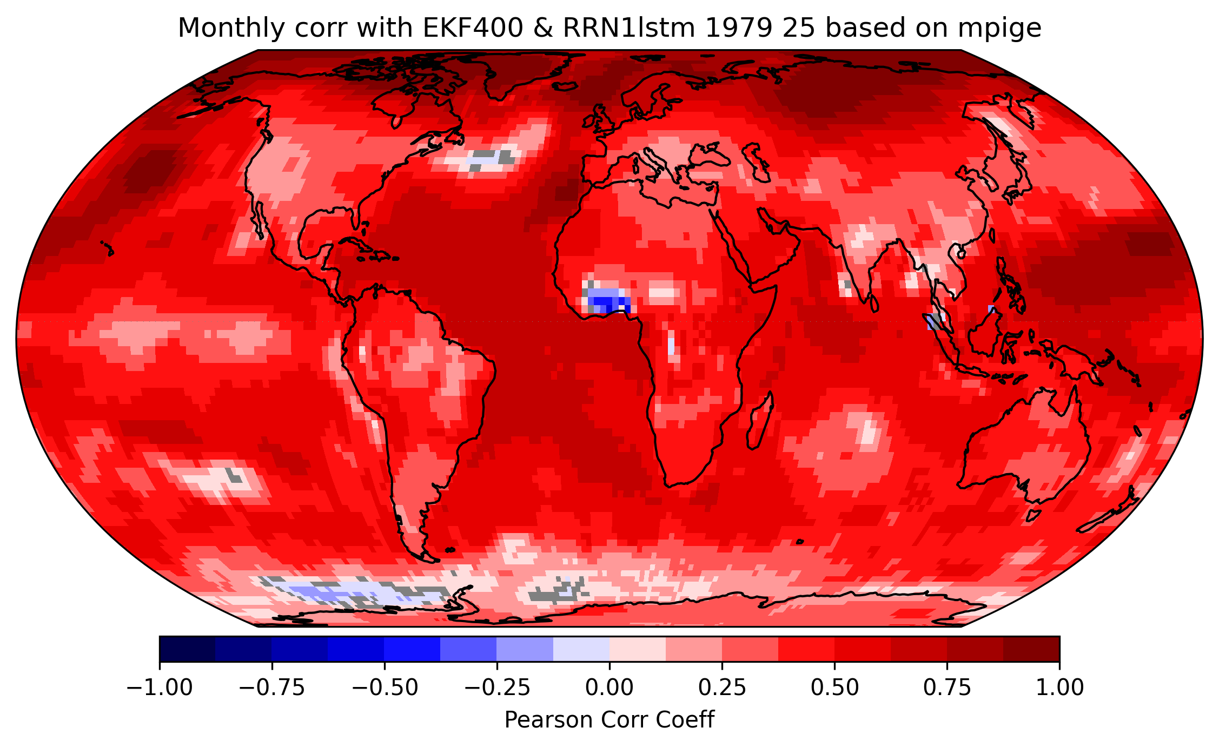
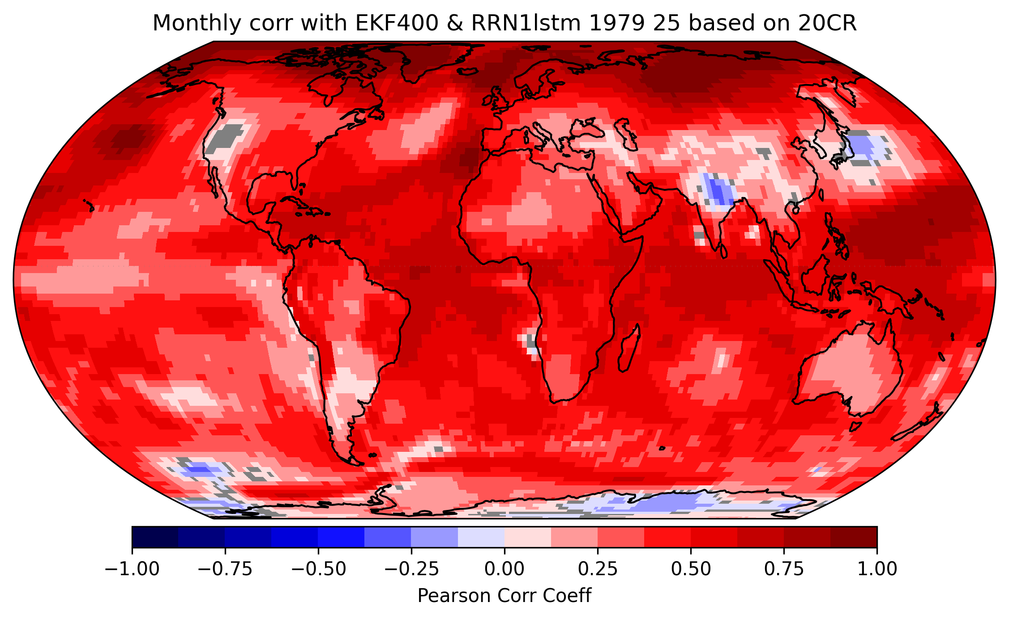
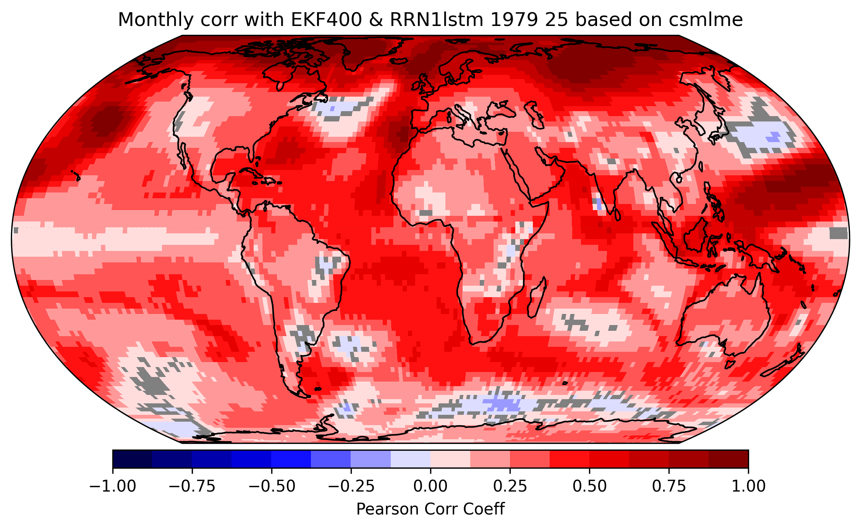
Correlation with EKF400 monthly
N= 4824

Slide 8
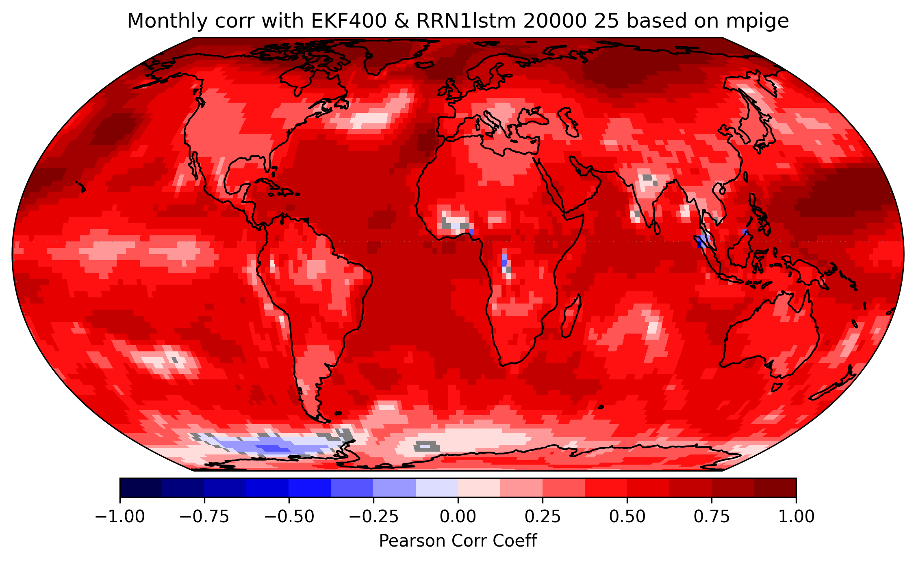
Correlation with EKF400
Train with 20000 months
Train with 1979 months

Slide 9
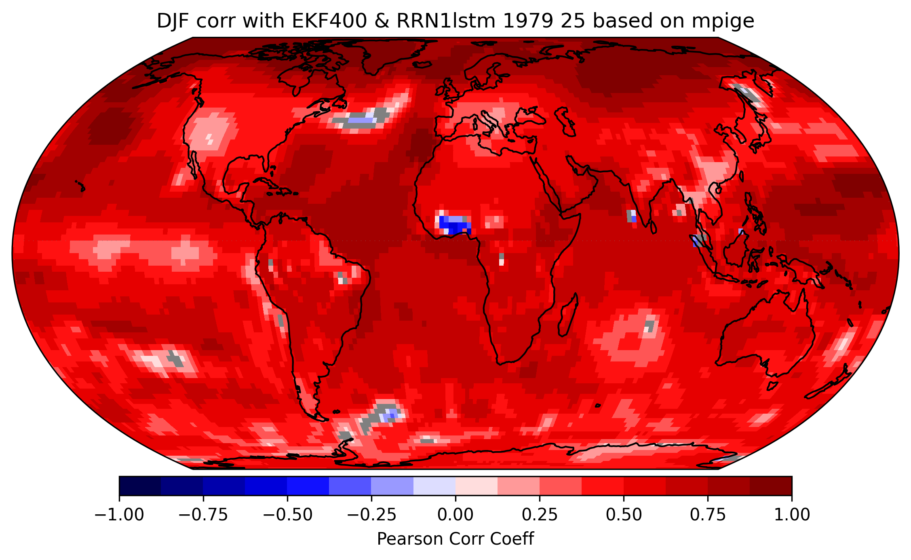
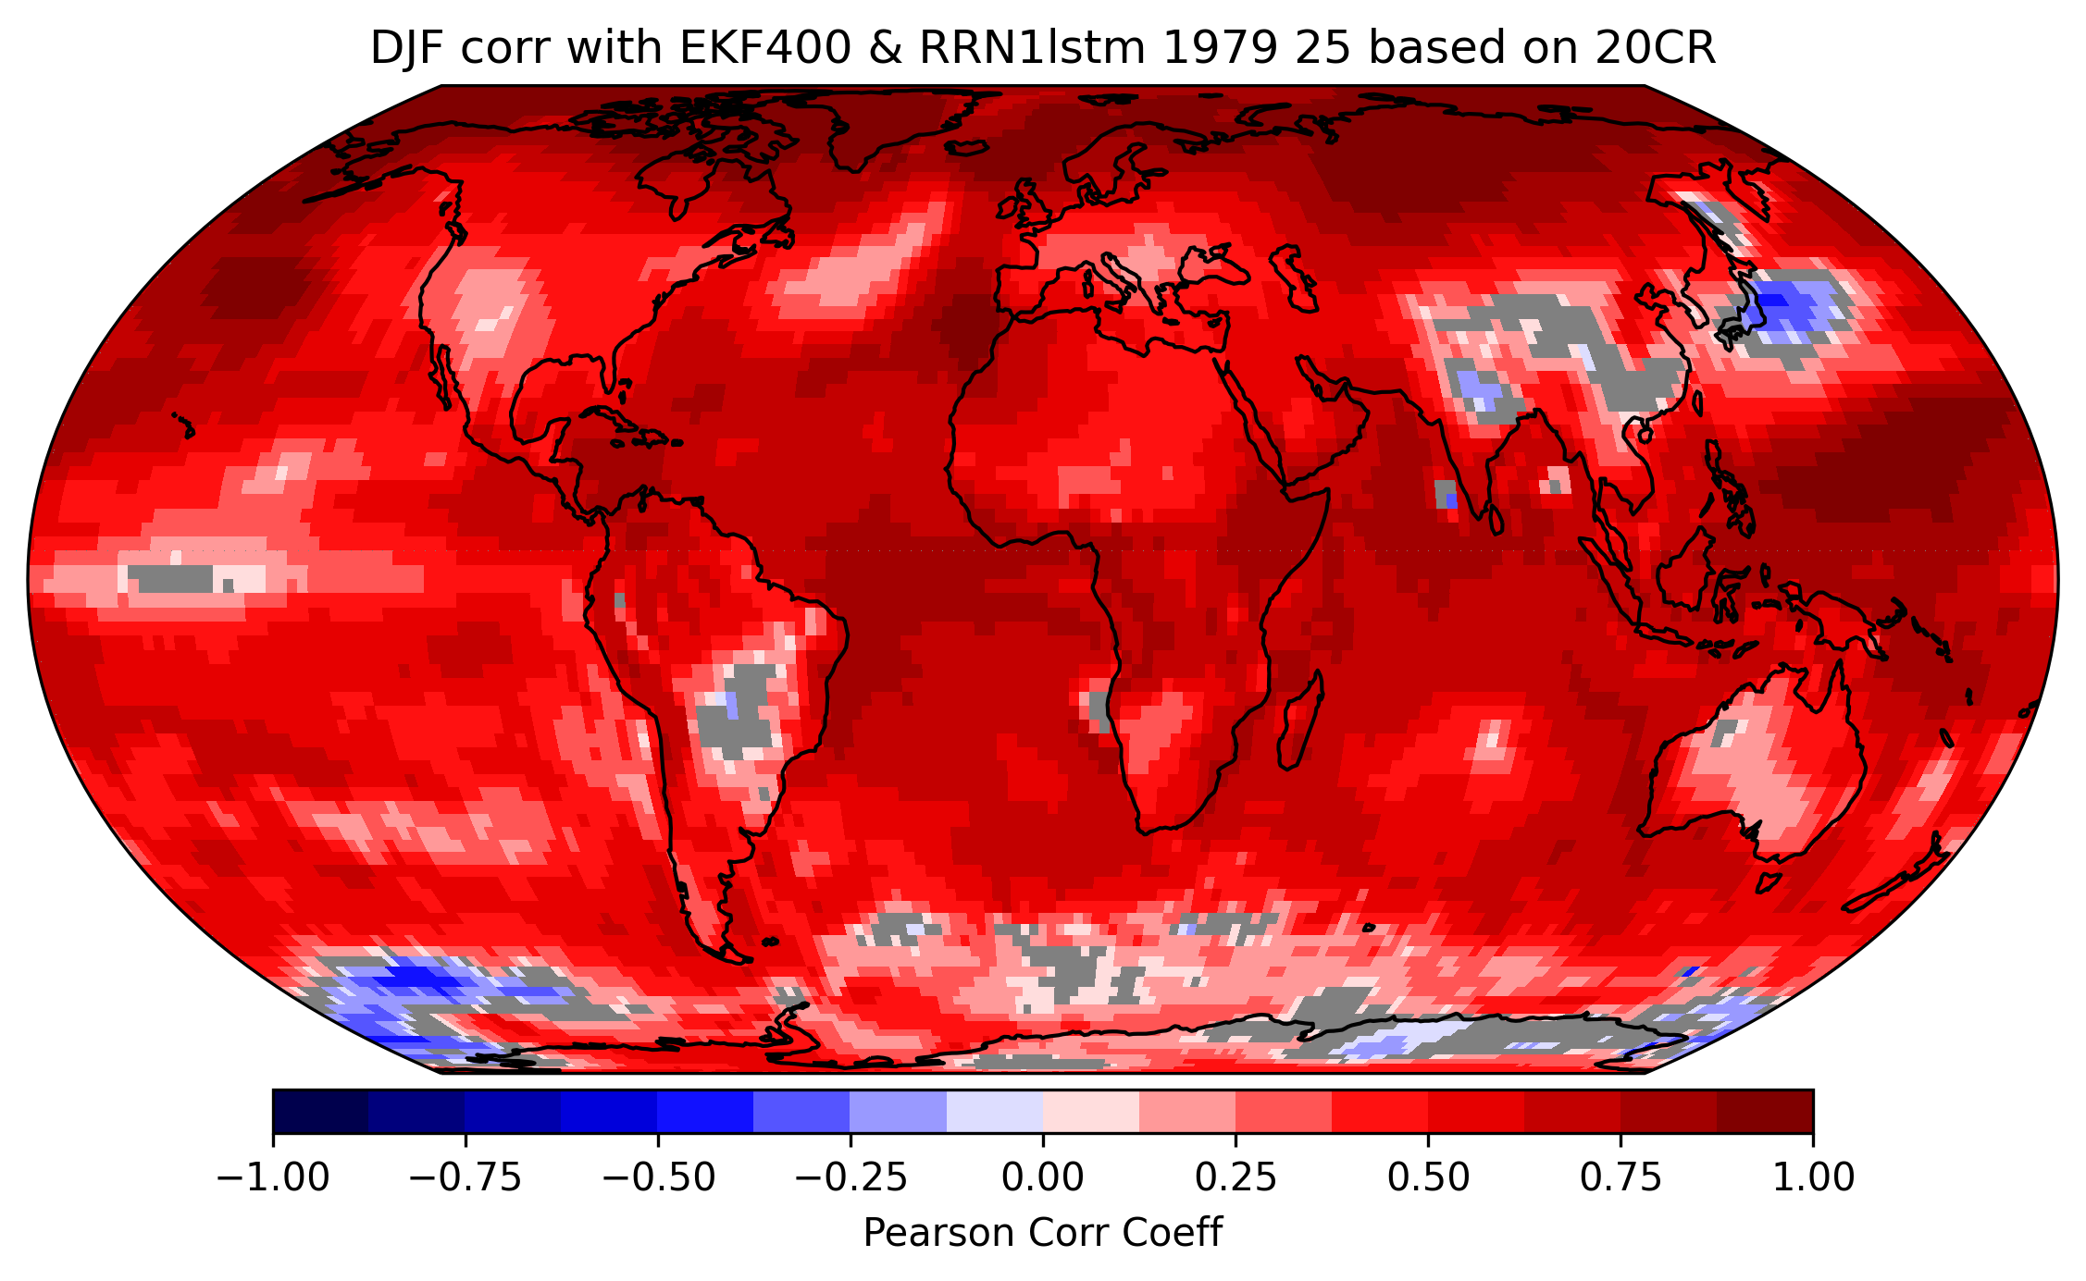
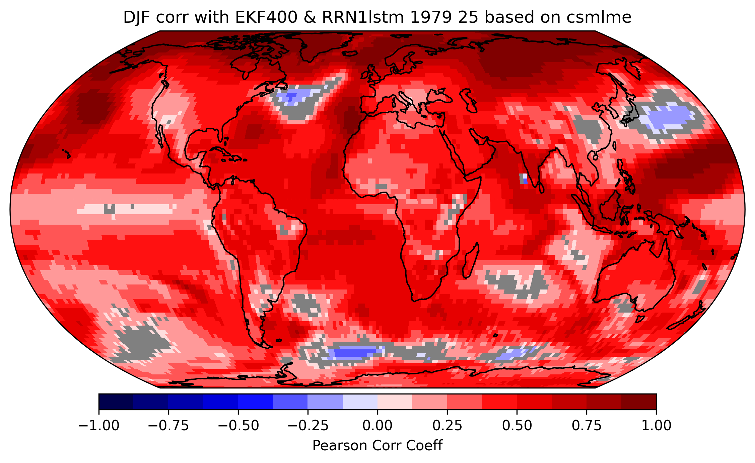
Correlation with EKF400 DJF
N= 4824/12 - 1

Slide 10
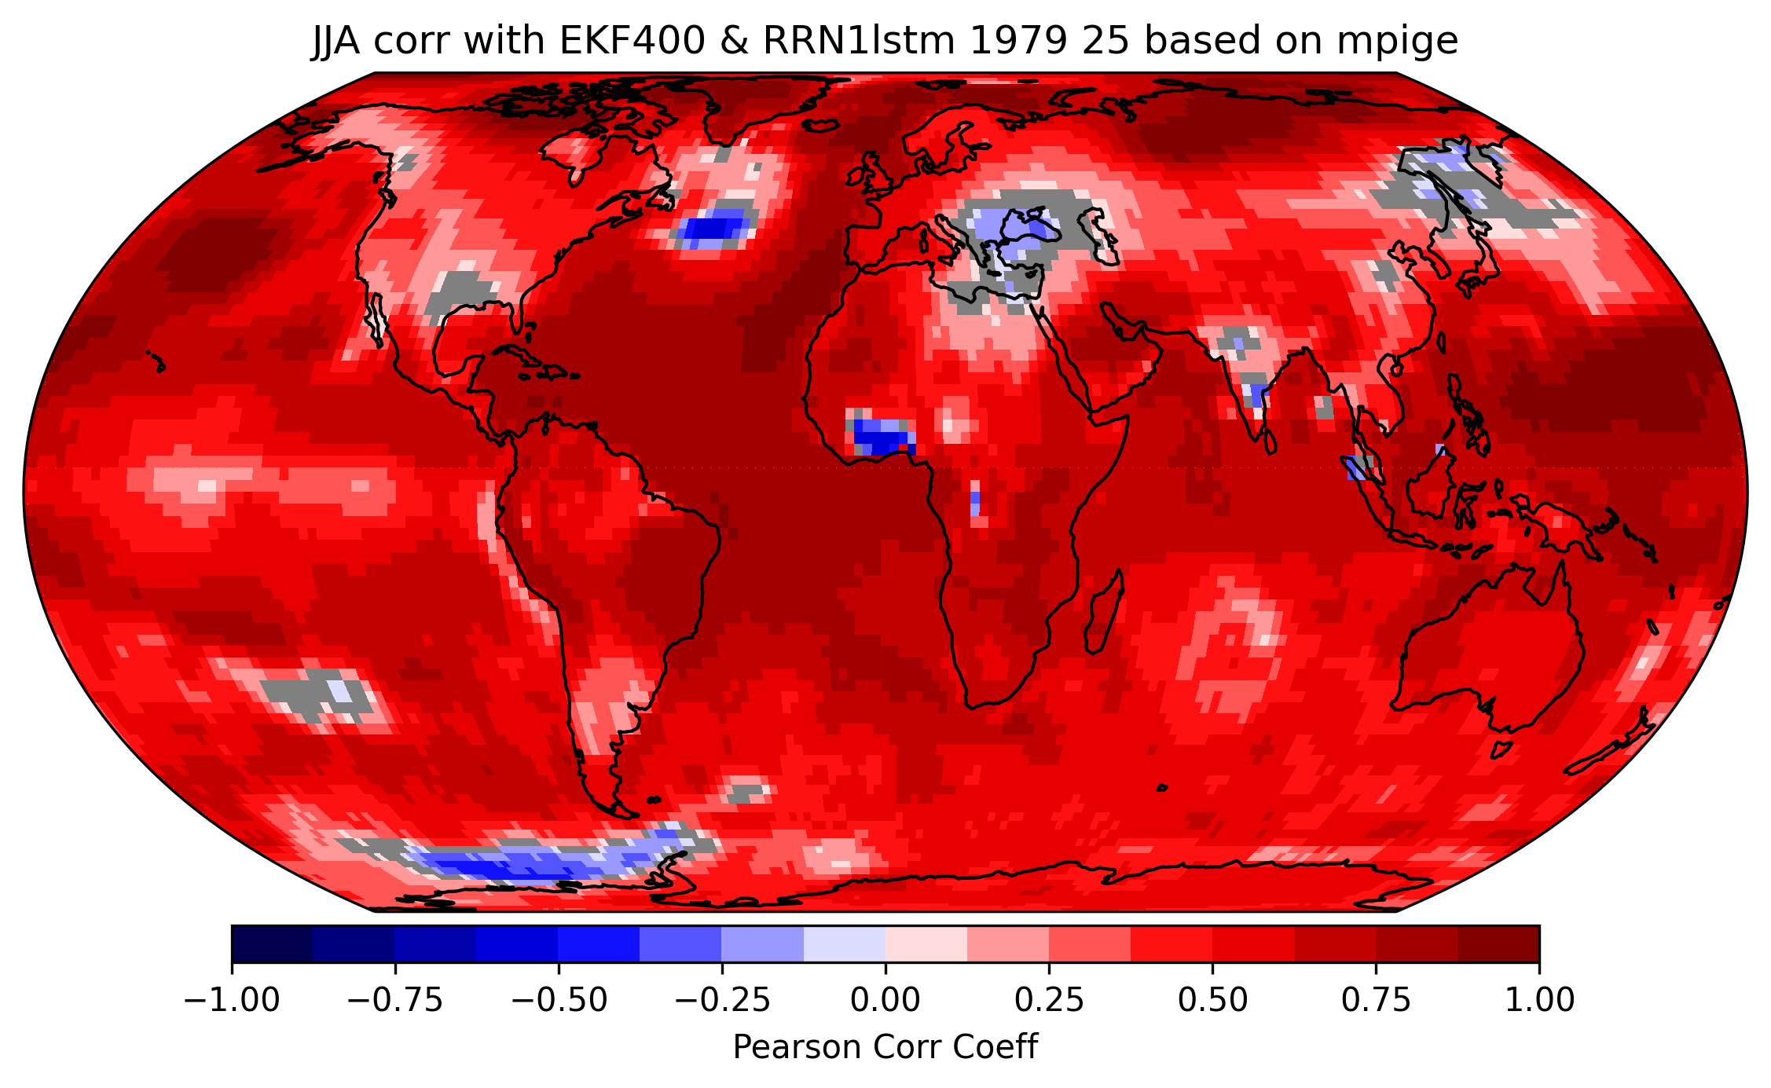
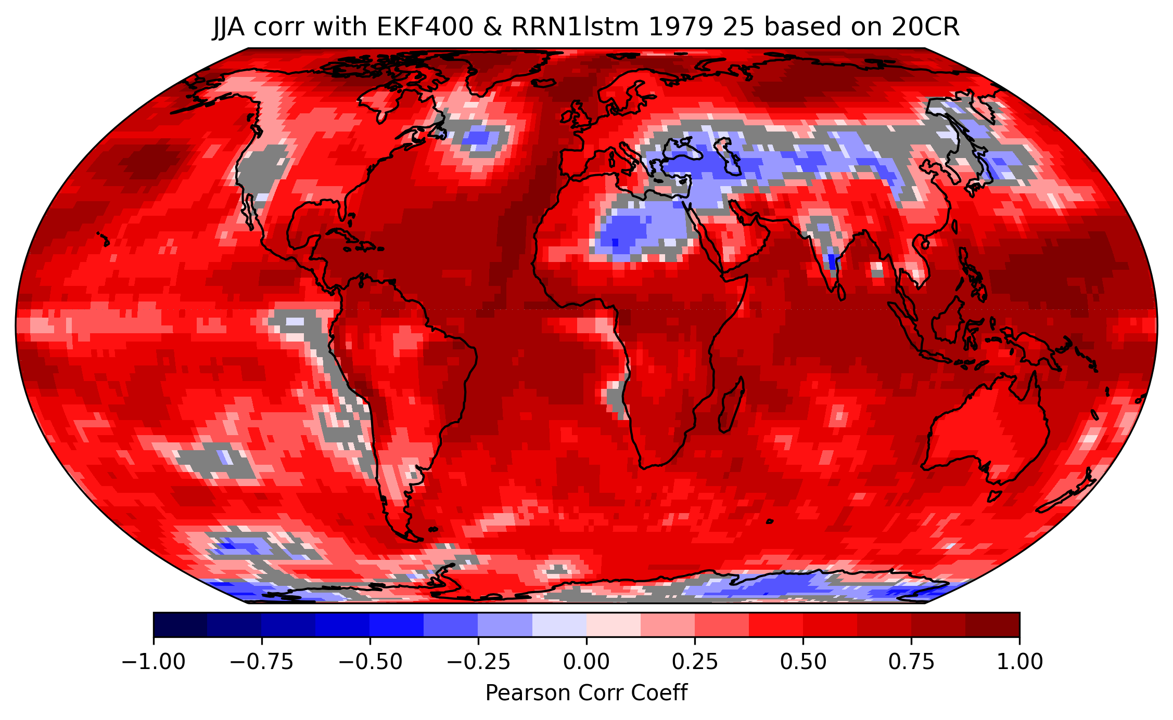
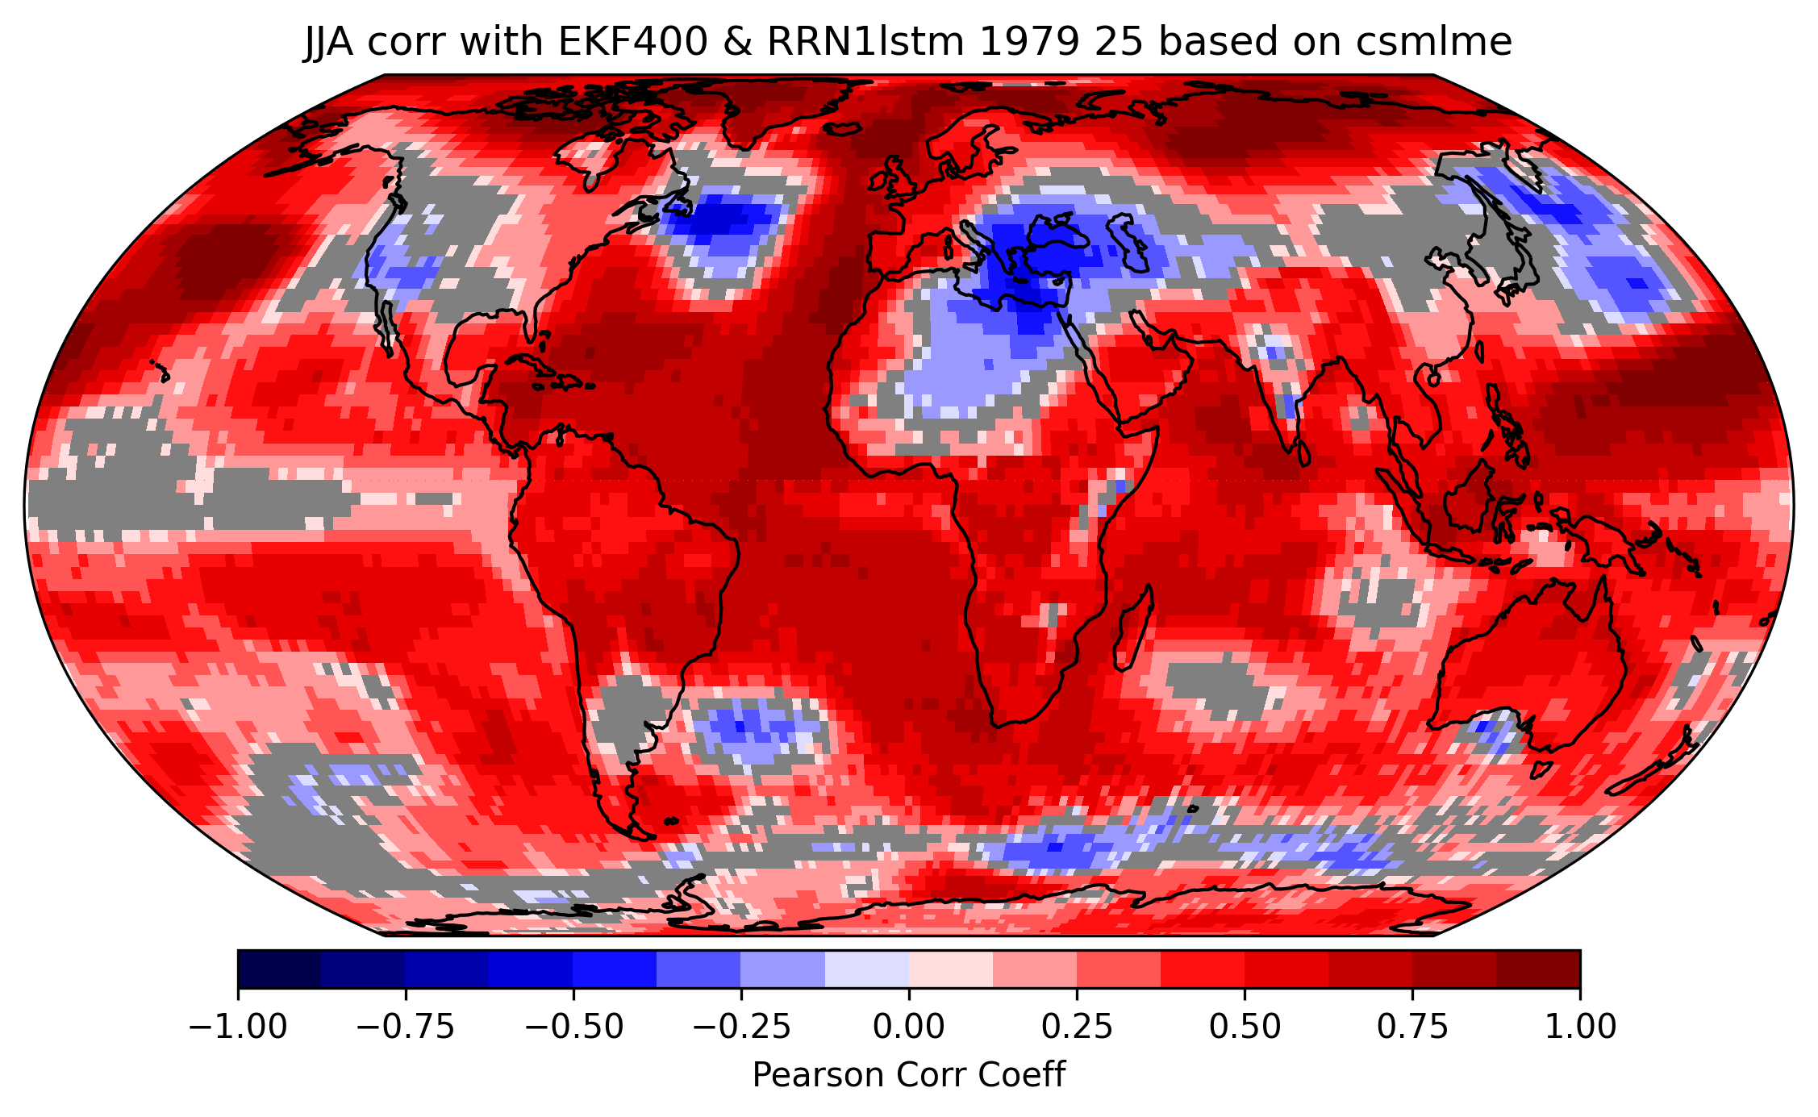
Correlation with EKF400 JJA
N= 4824/12

Slide 11
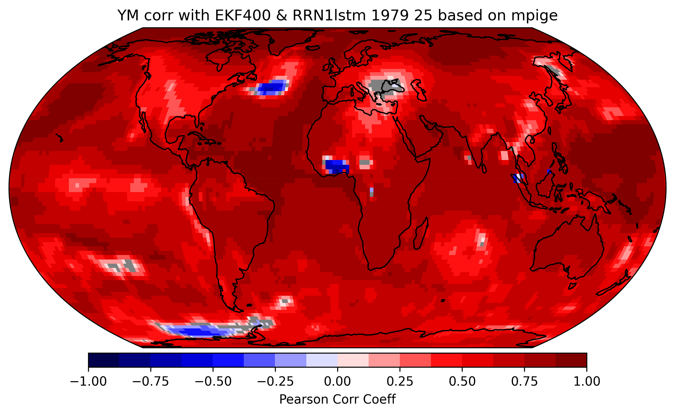
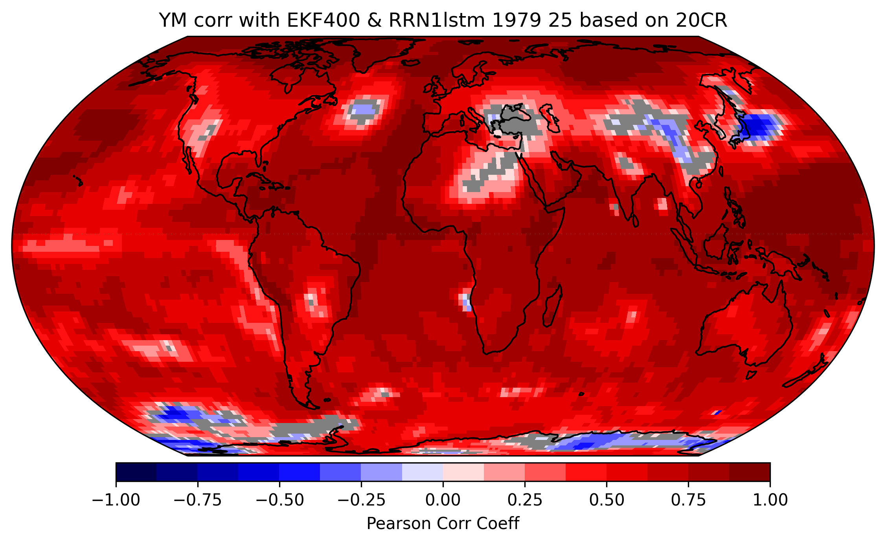
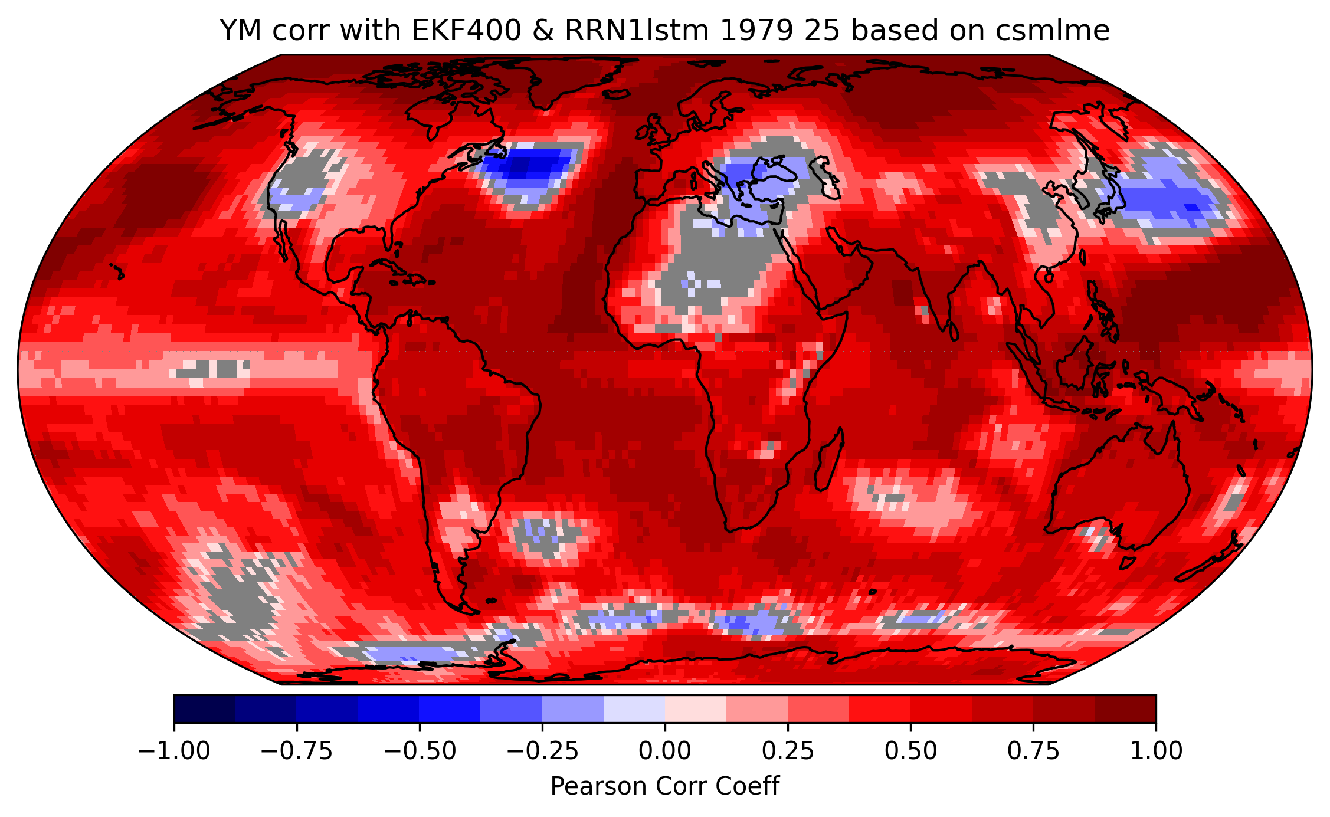
Correlation with EKF400 yearly mean
N= 4824/12

Slide 12
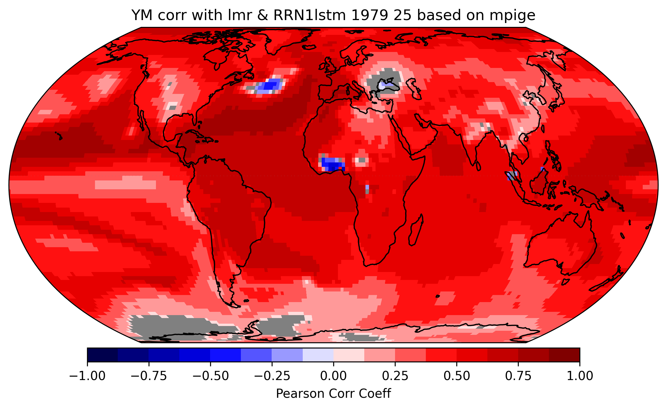
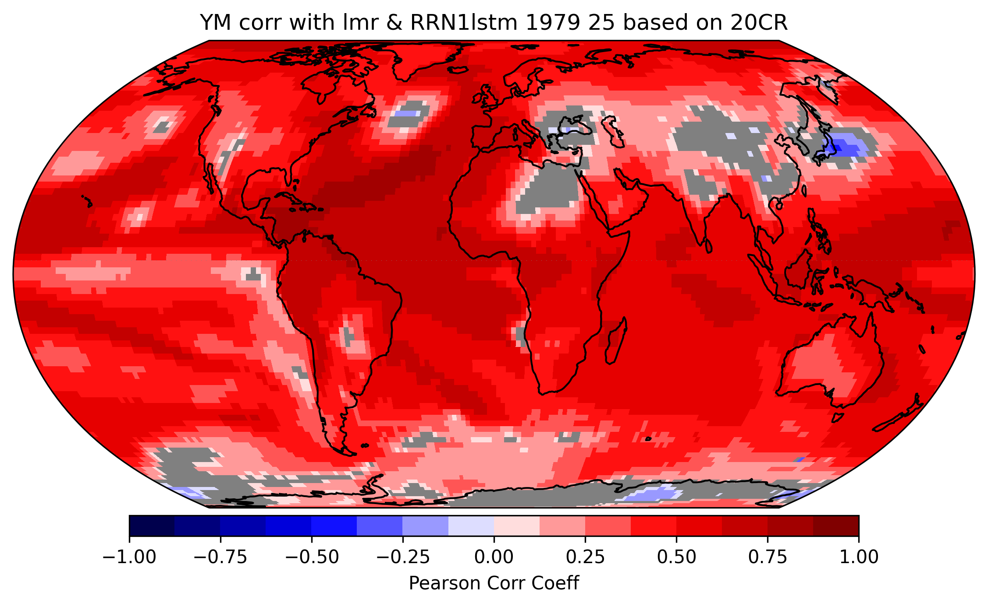
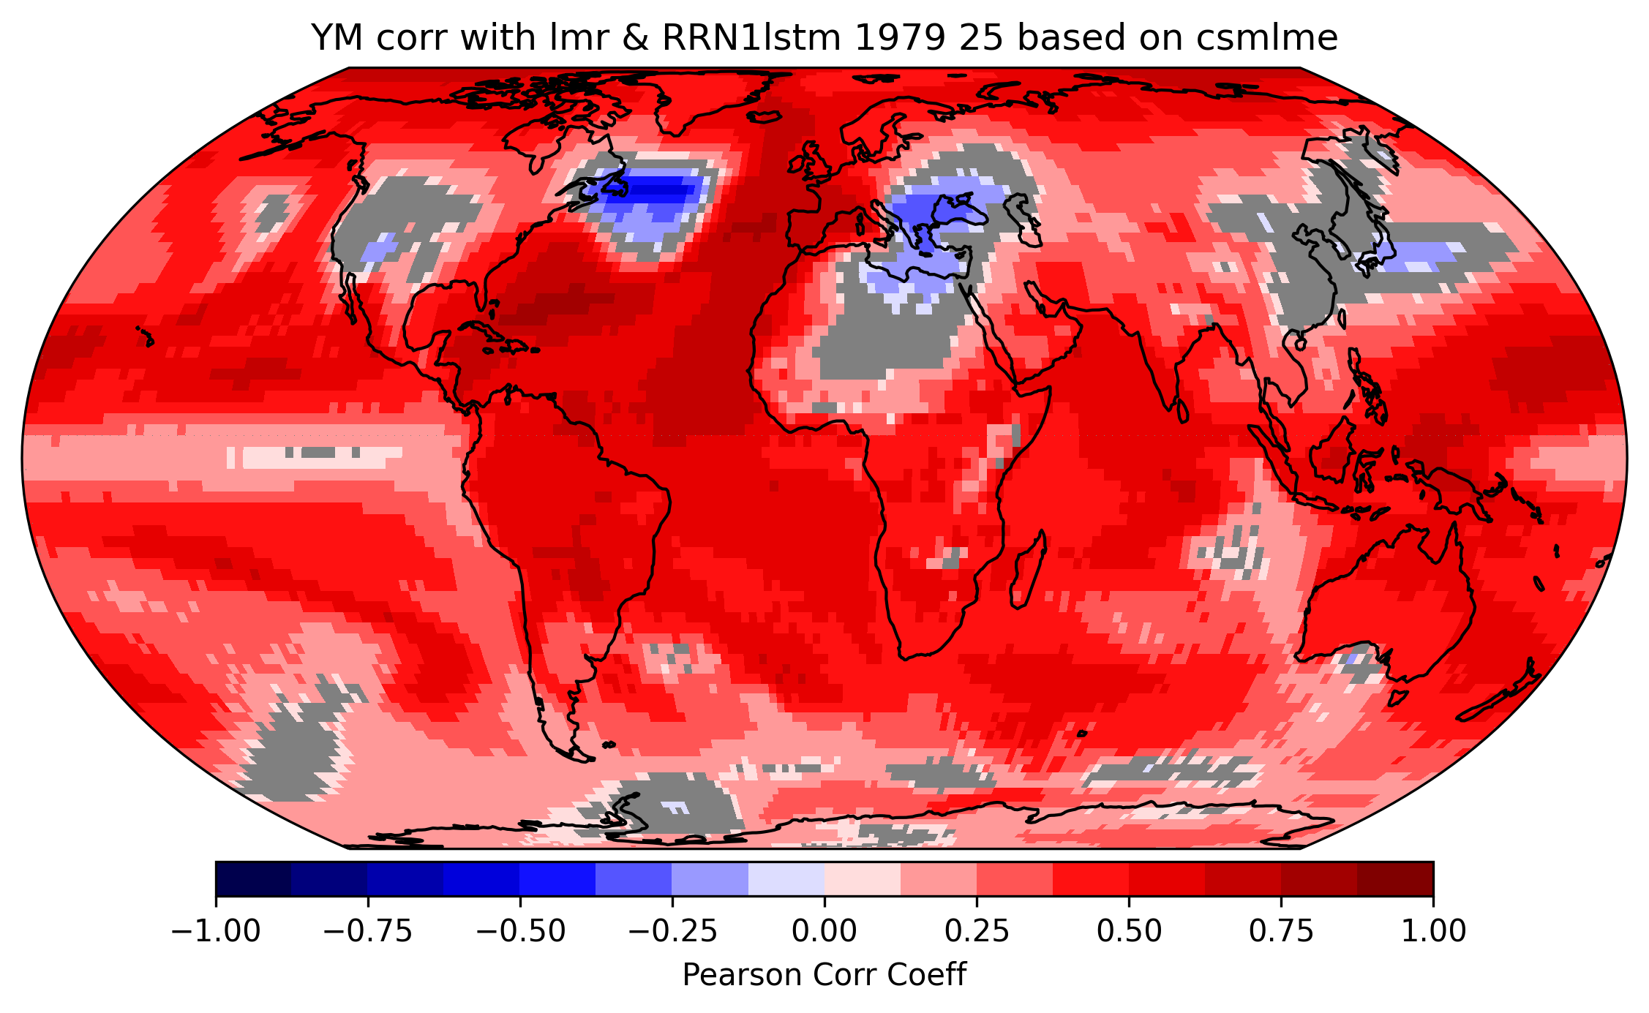
Correlation with LMR yearly mean

Slide 13
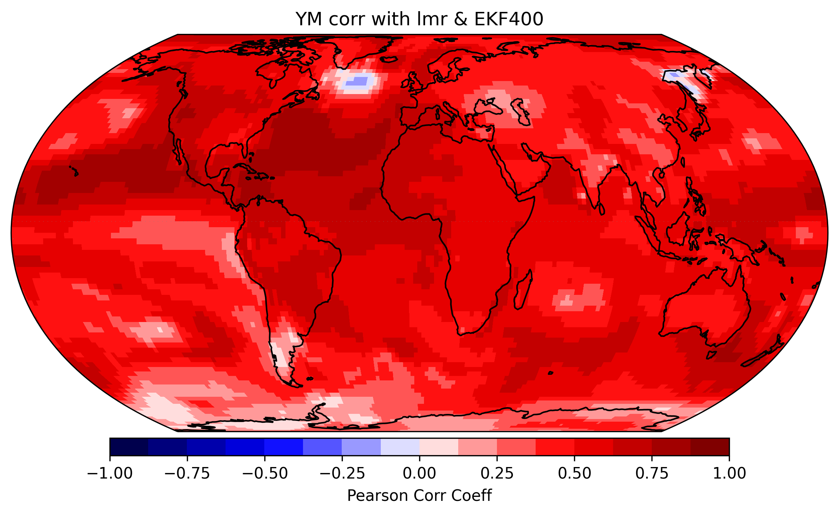
Correlation with LMR yearly mean

Slide 14
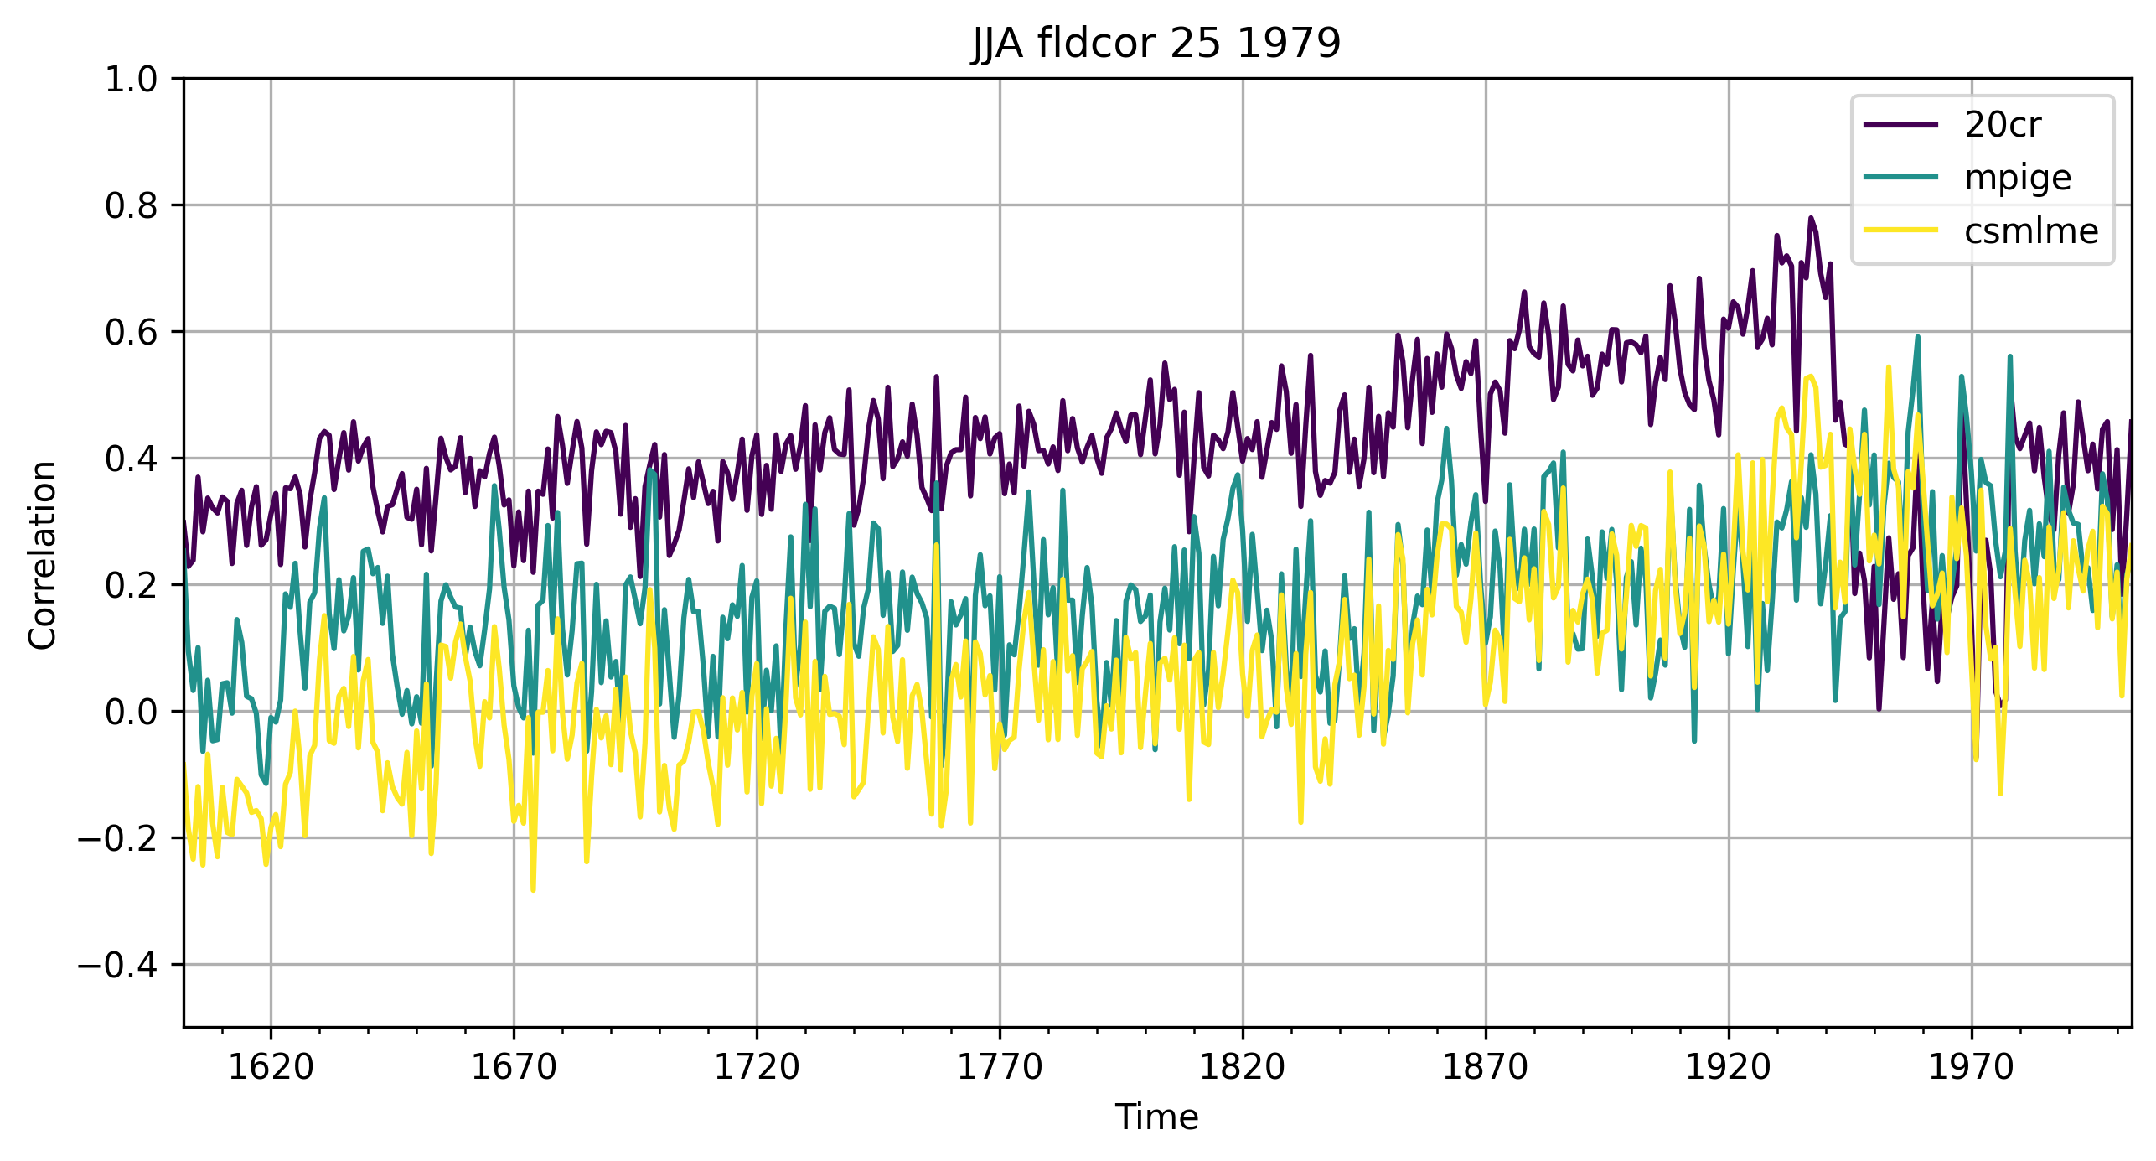
Correlation with EKF400 JJA

Slide 15
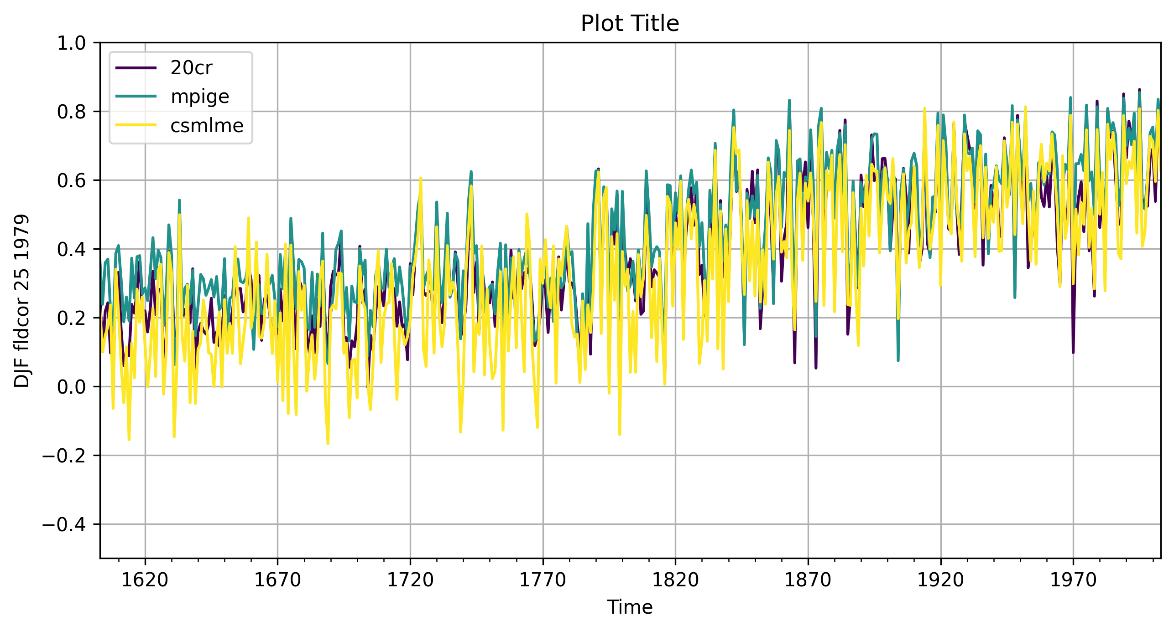
Correlation with EKF400 DJF

Slide 16
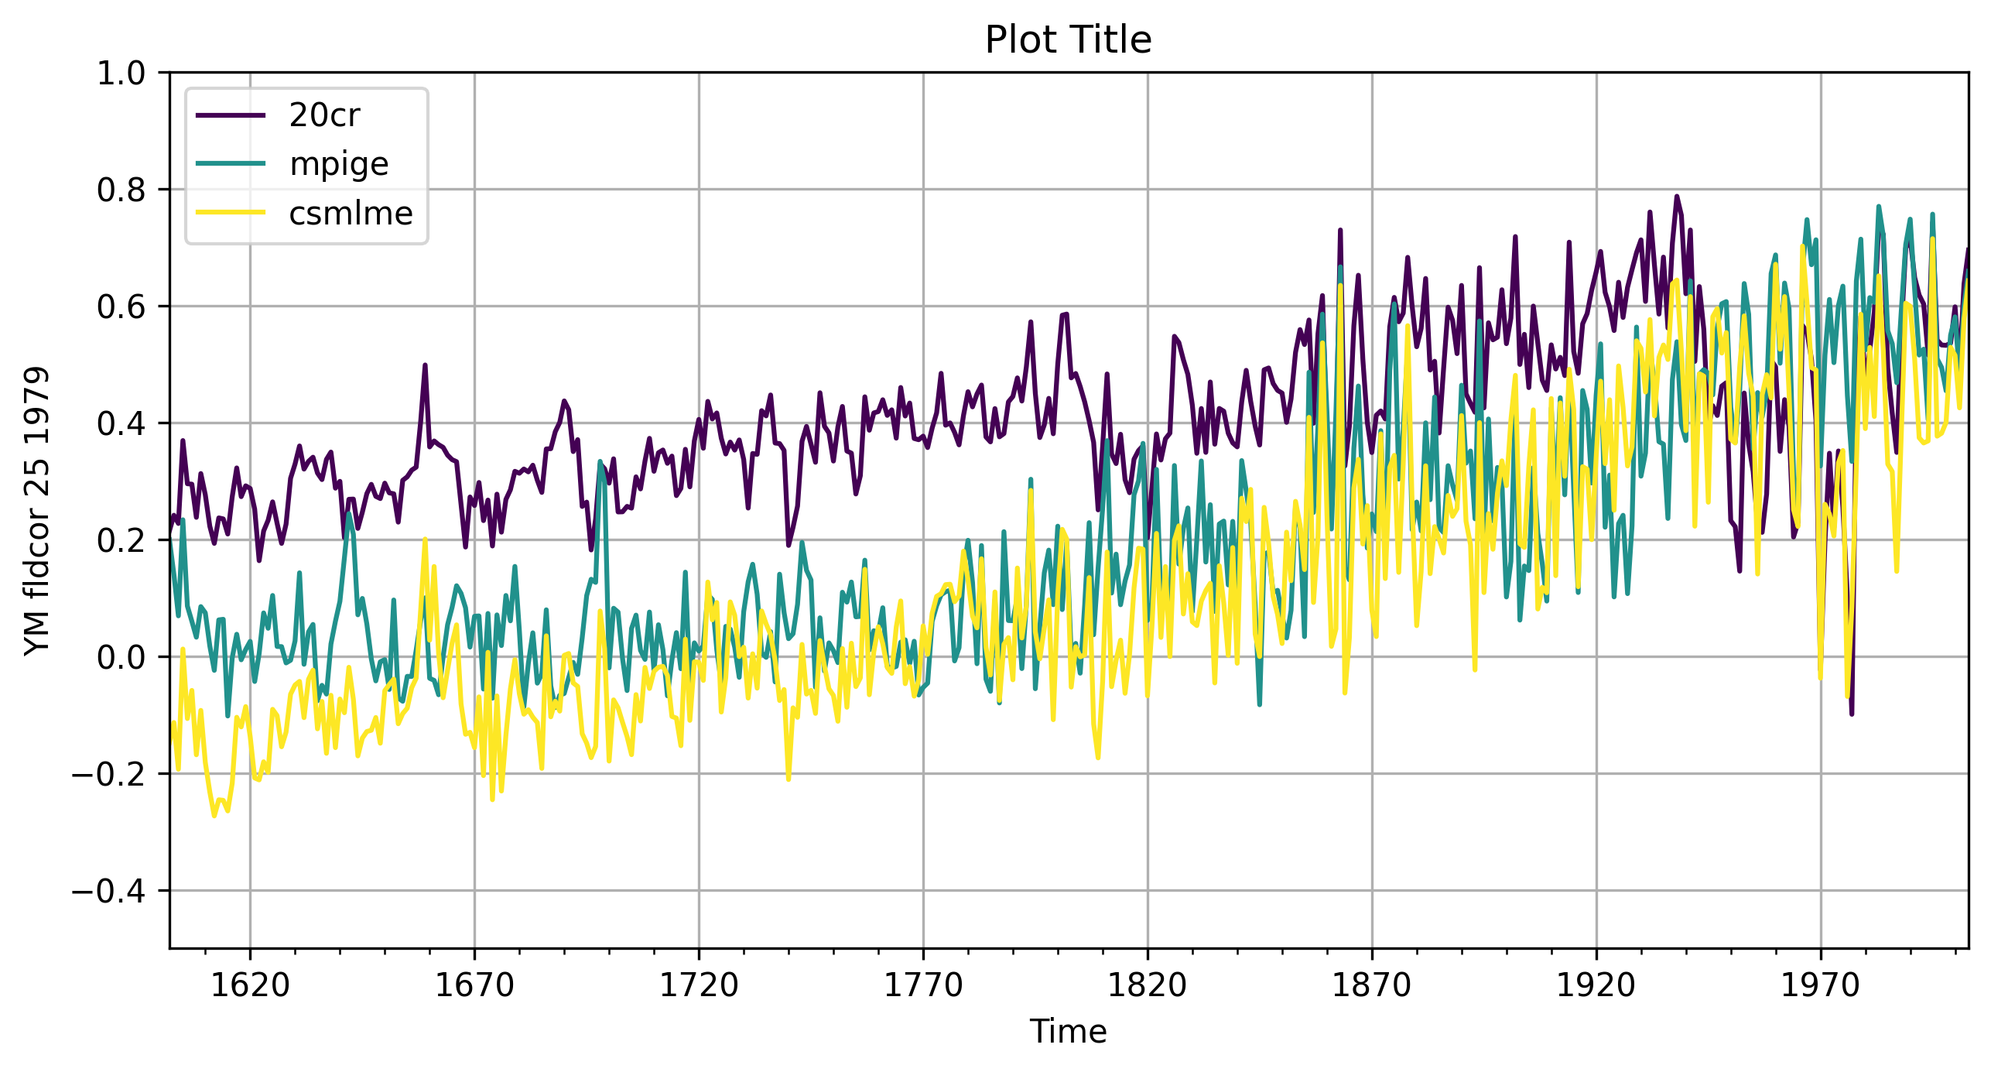
Correlation with EKF400 Yearly Mean

Slide 17
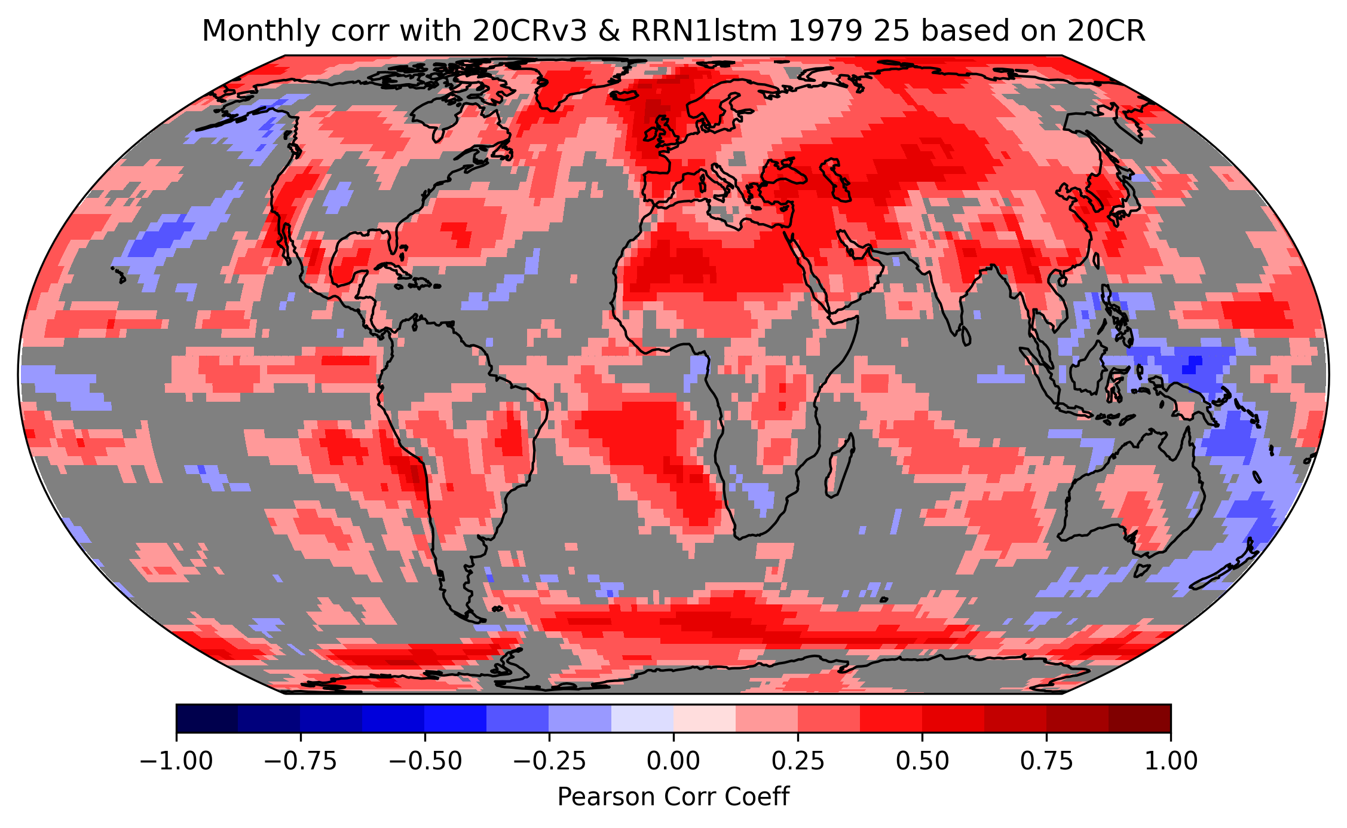
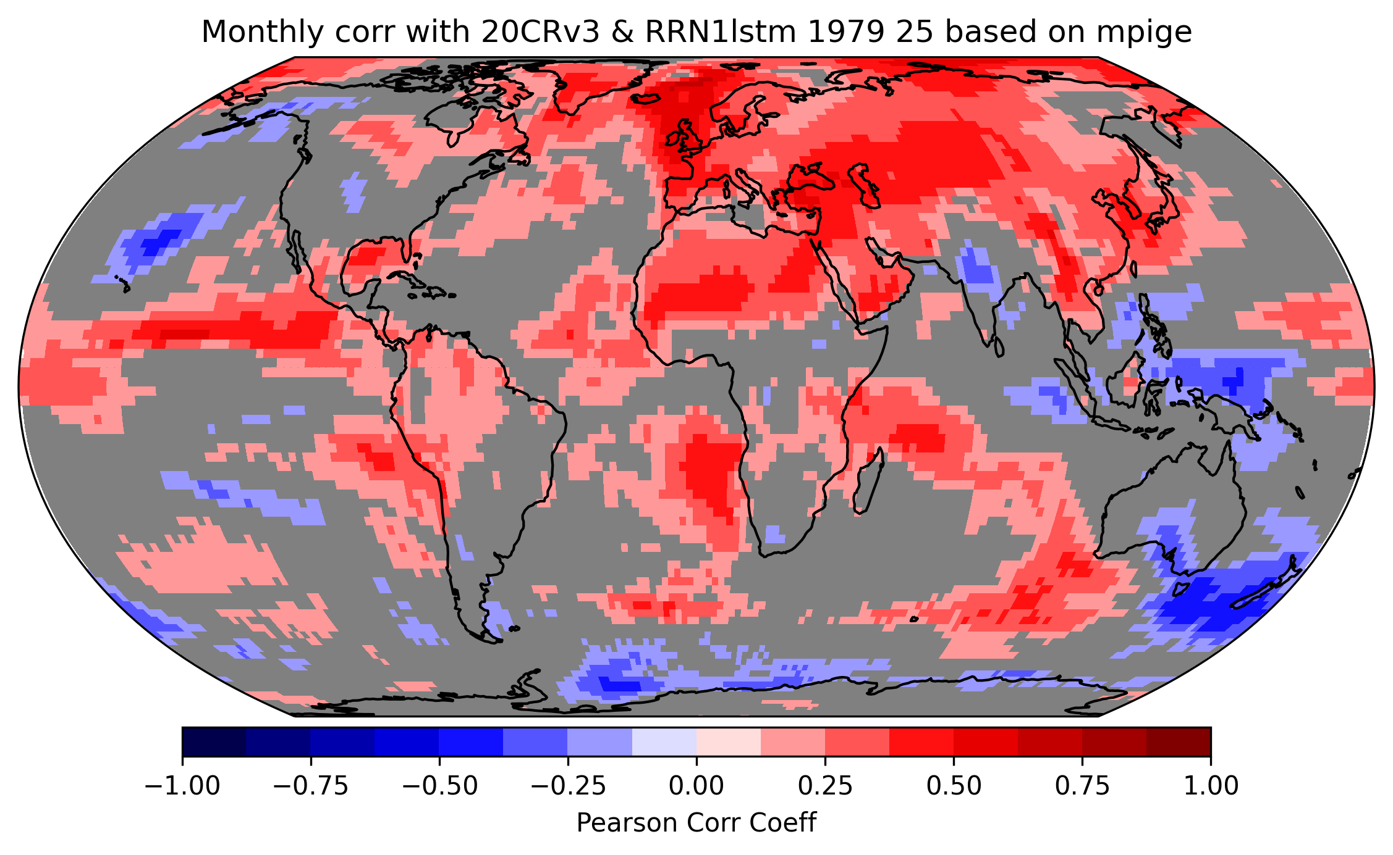
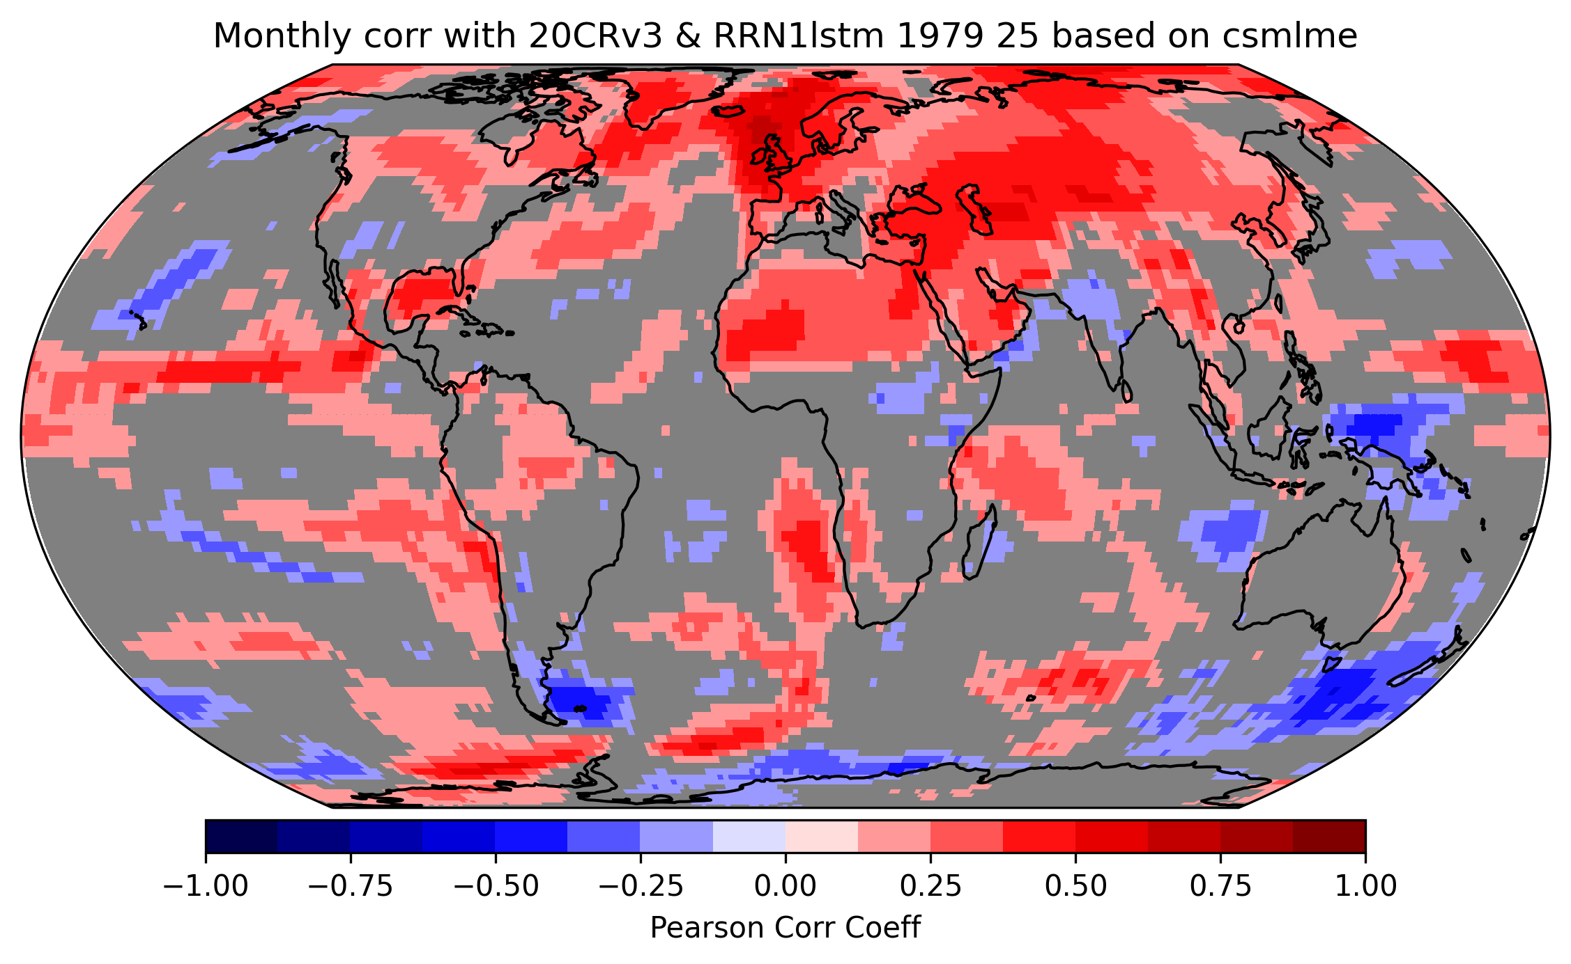
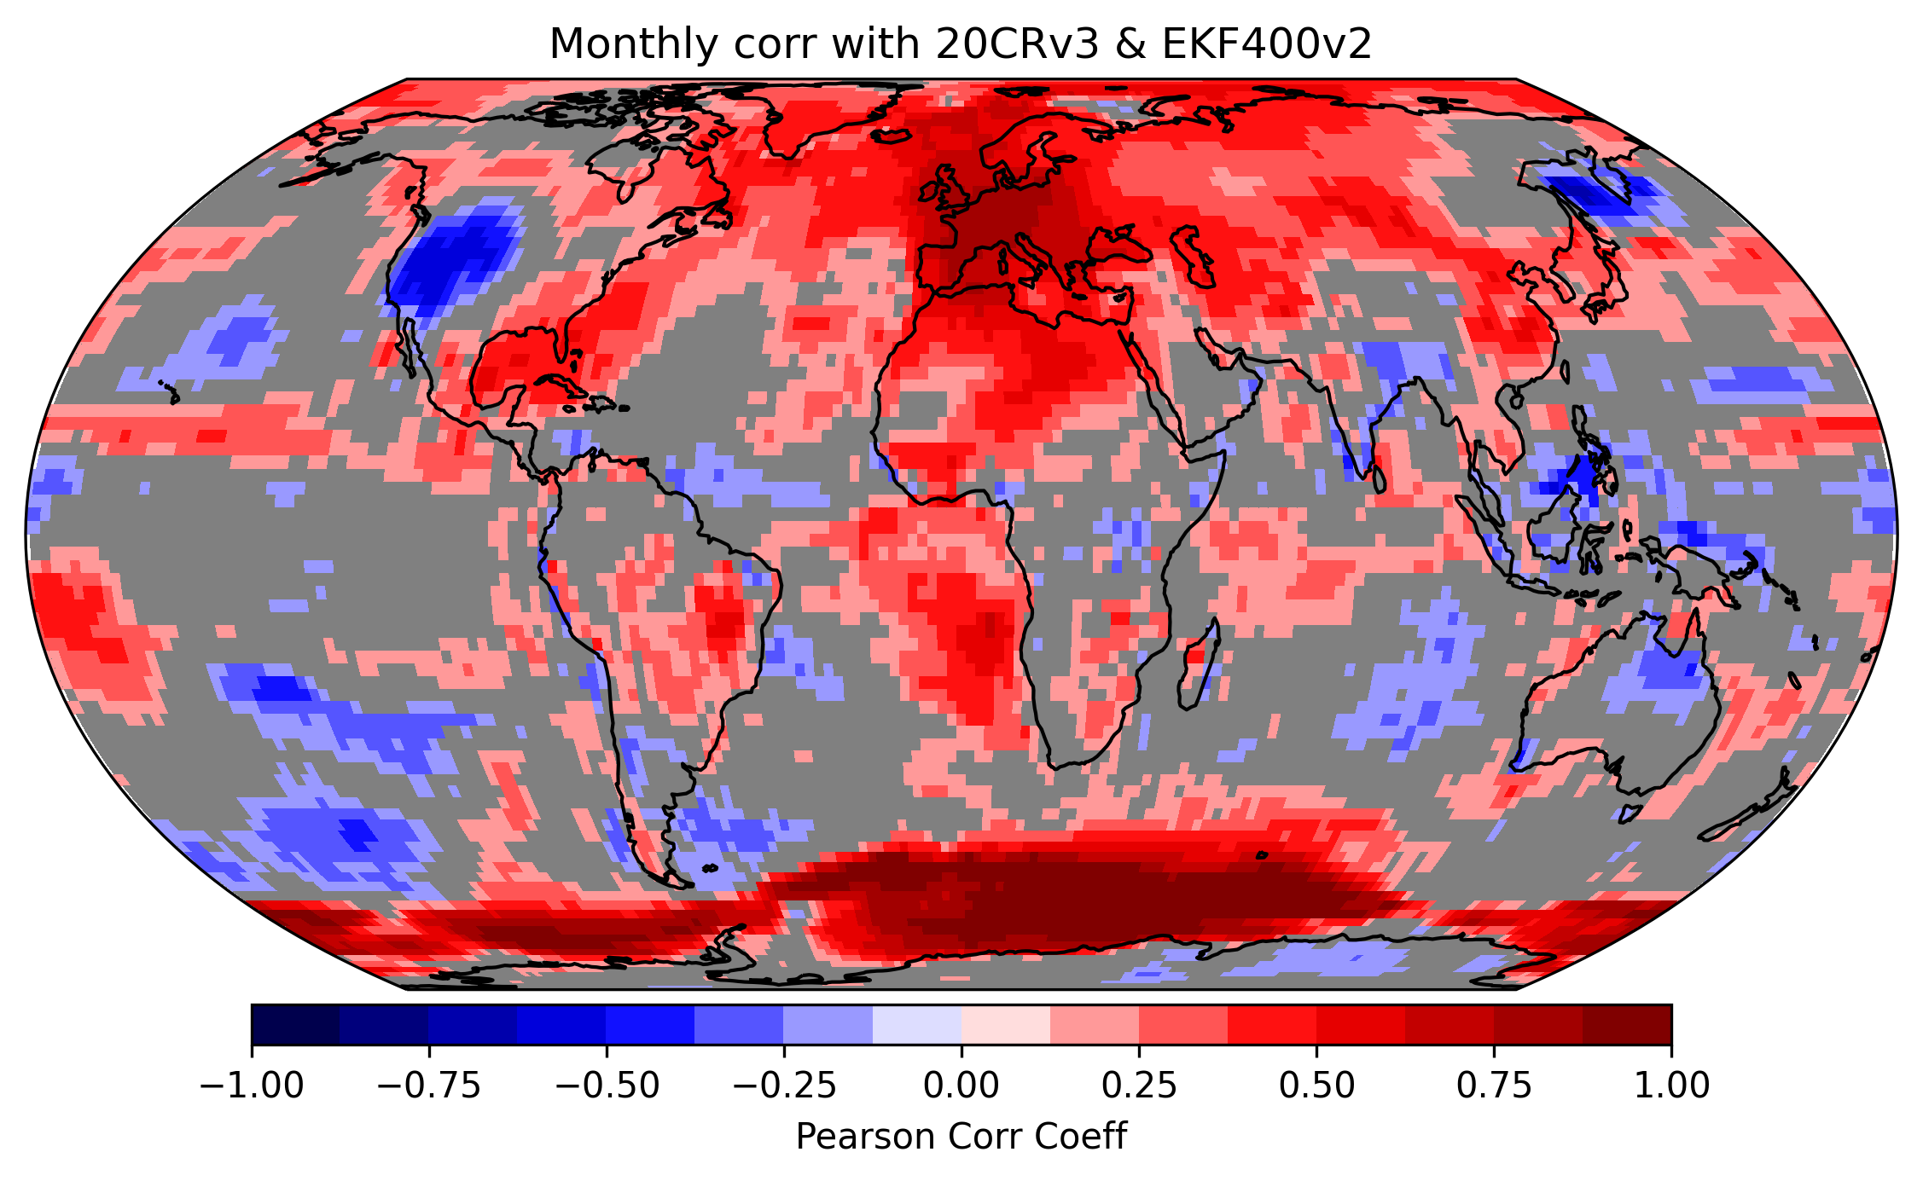
Correlation with 20CRv3 1836–1850 monthly

Slide 18
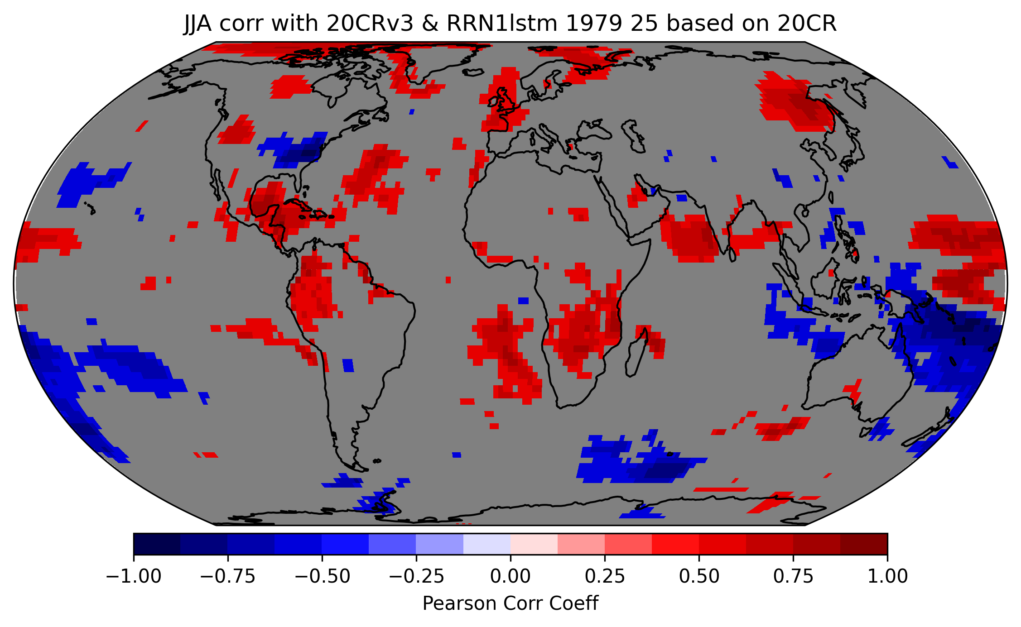
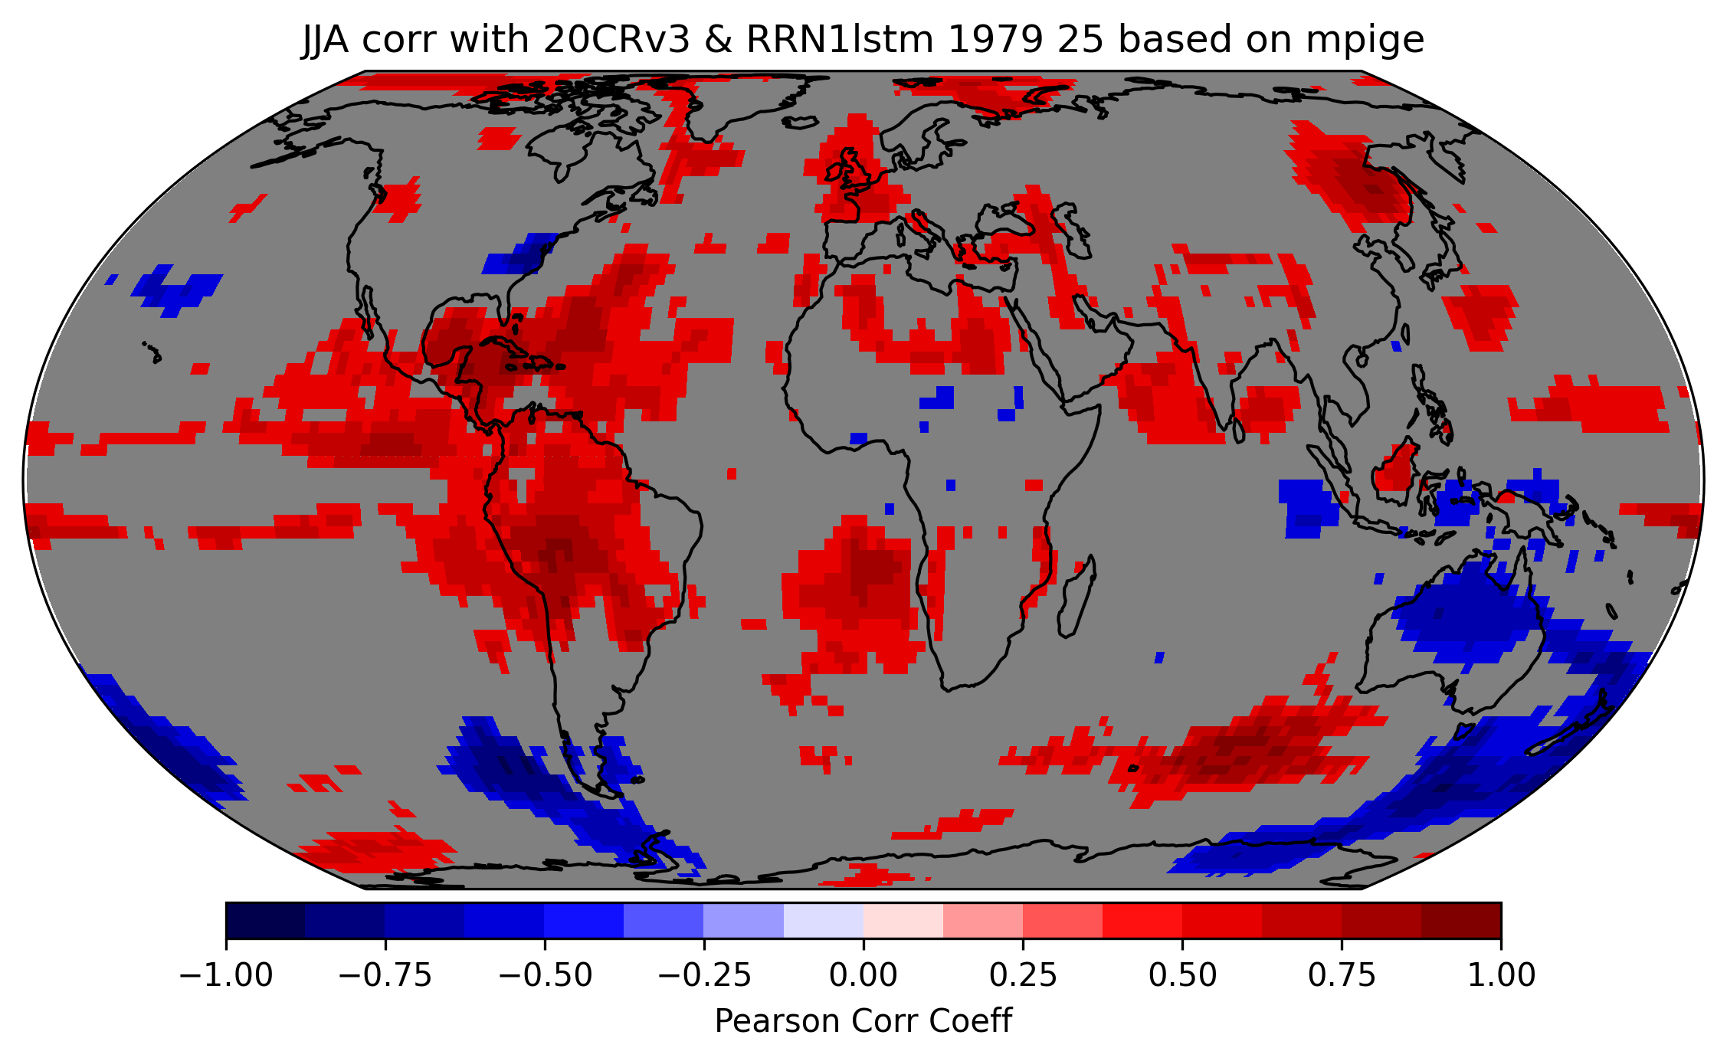
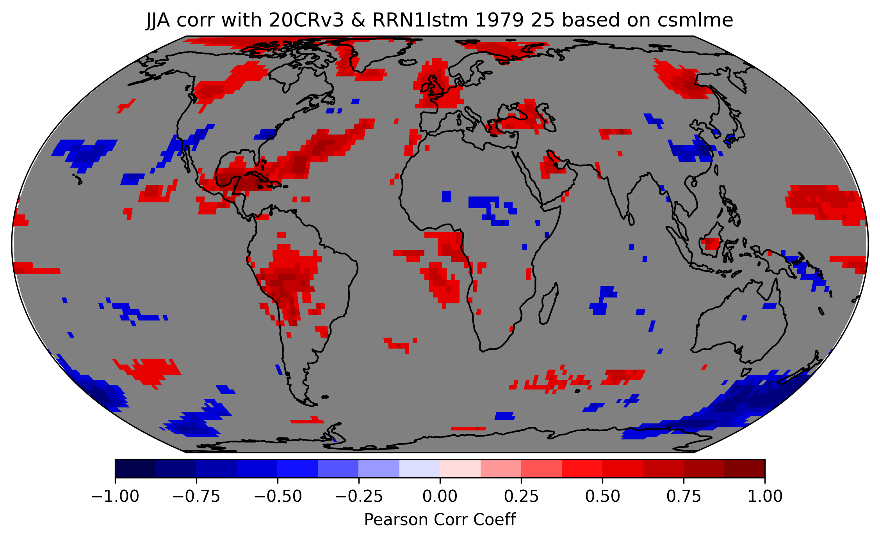
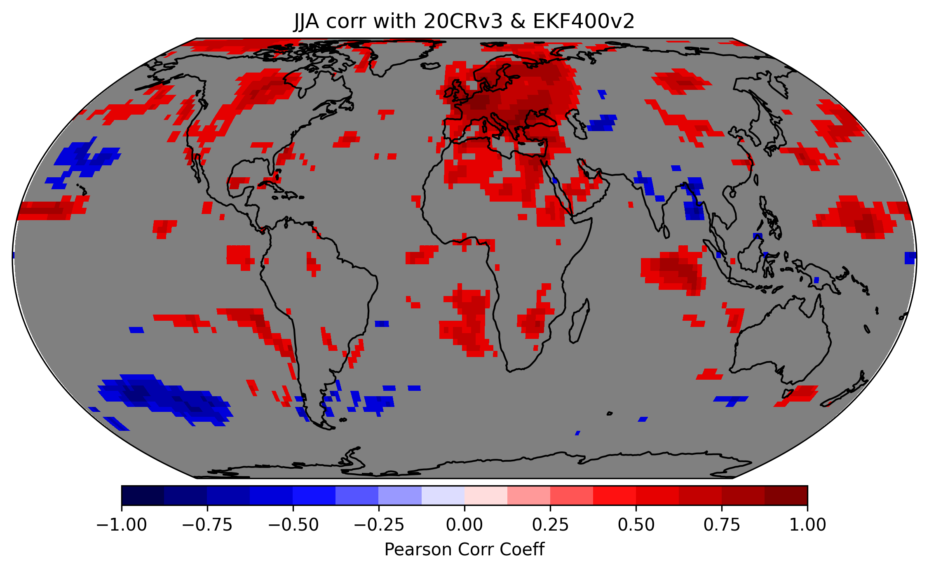
Correlation with 20CRv3 1836–1850 JJA

Slide 19
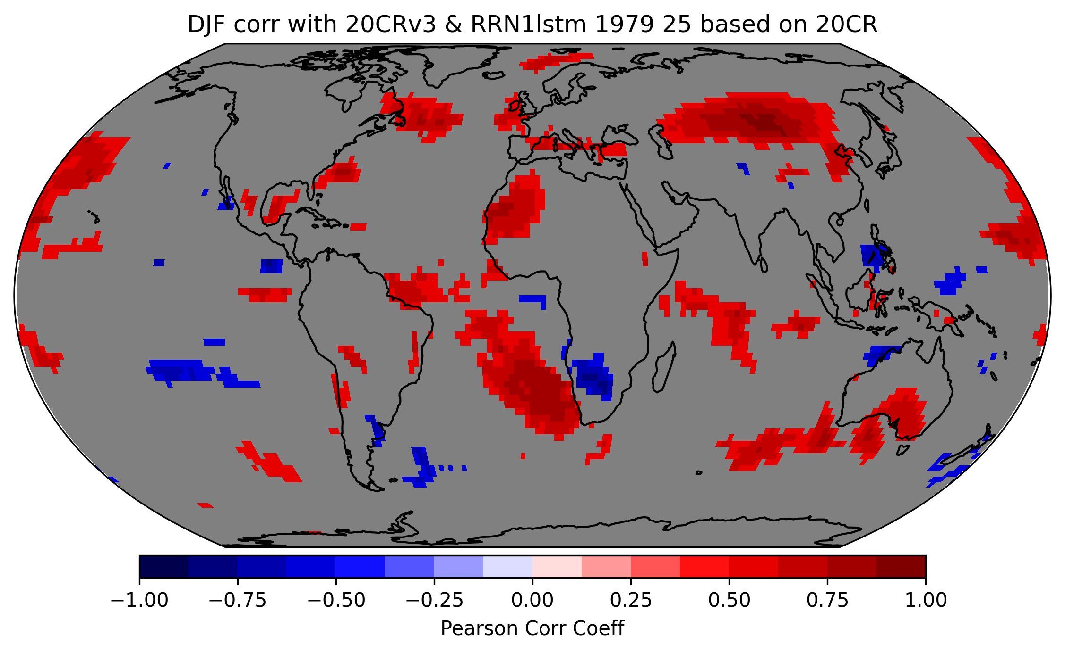
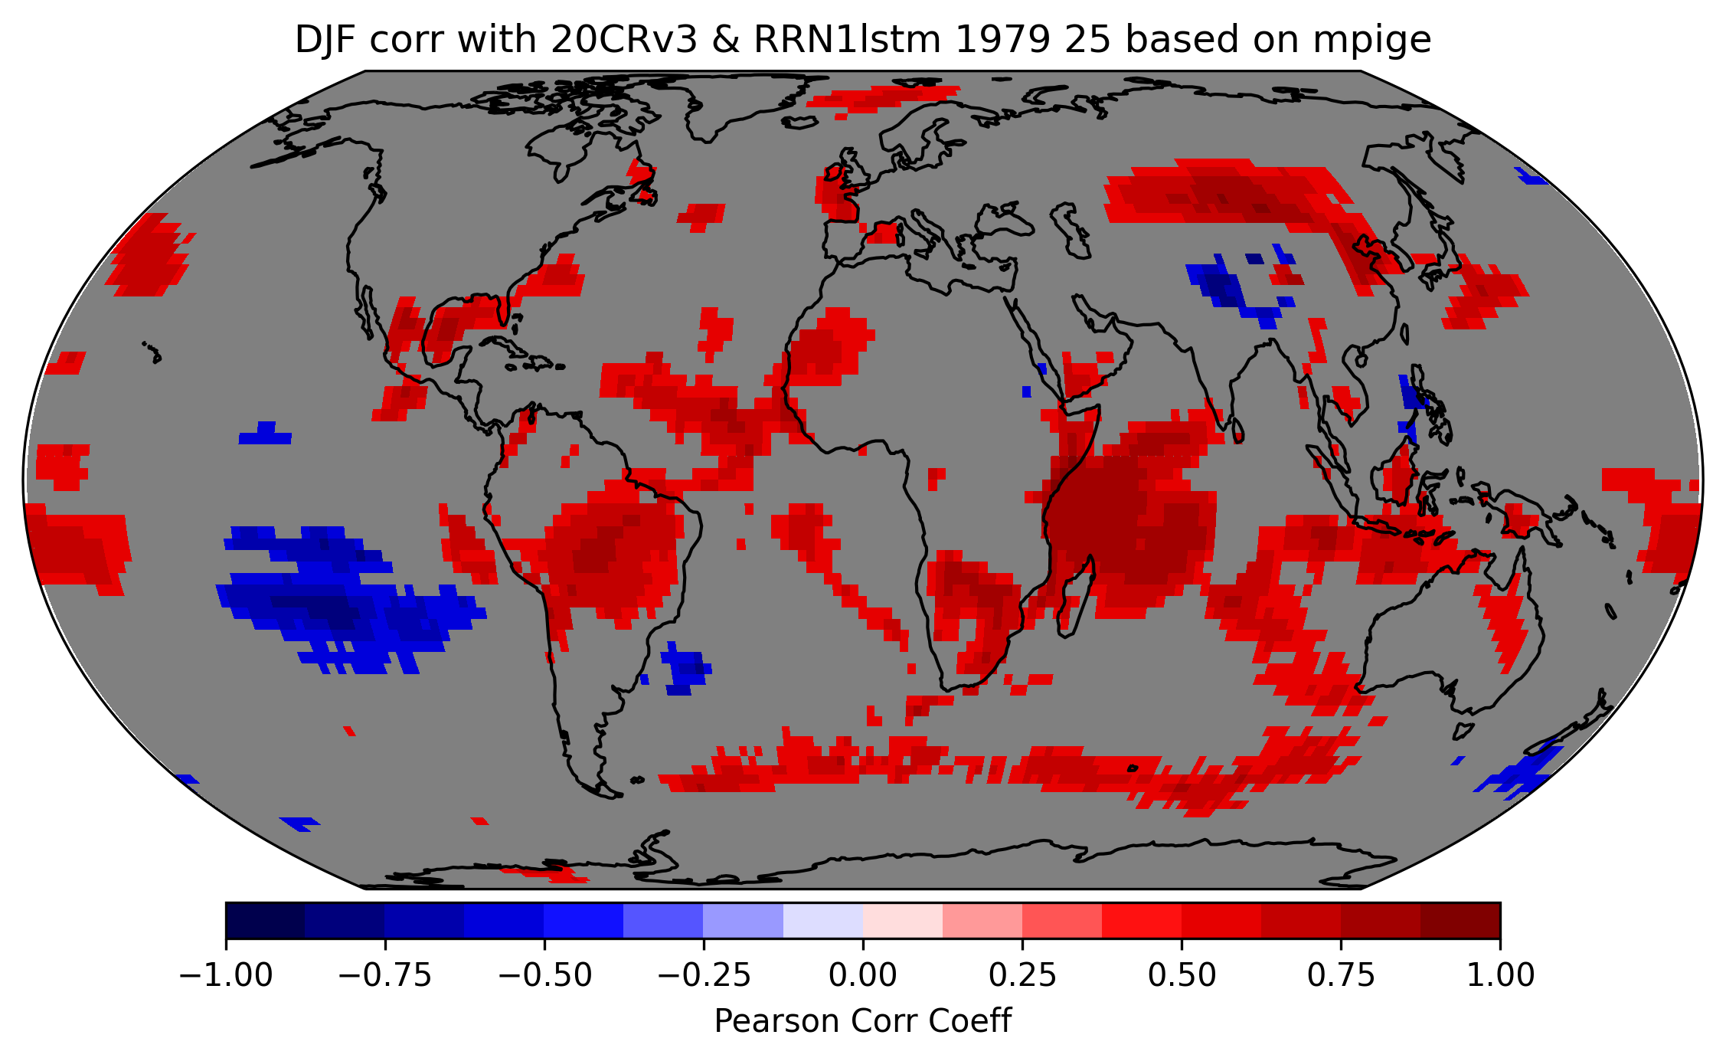
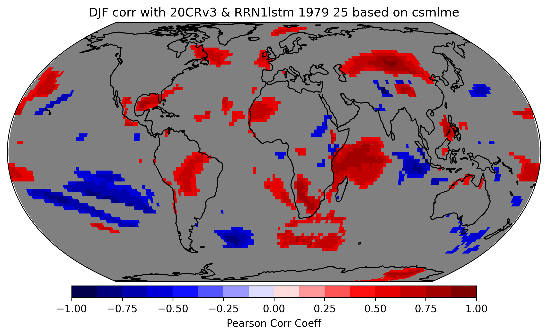
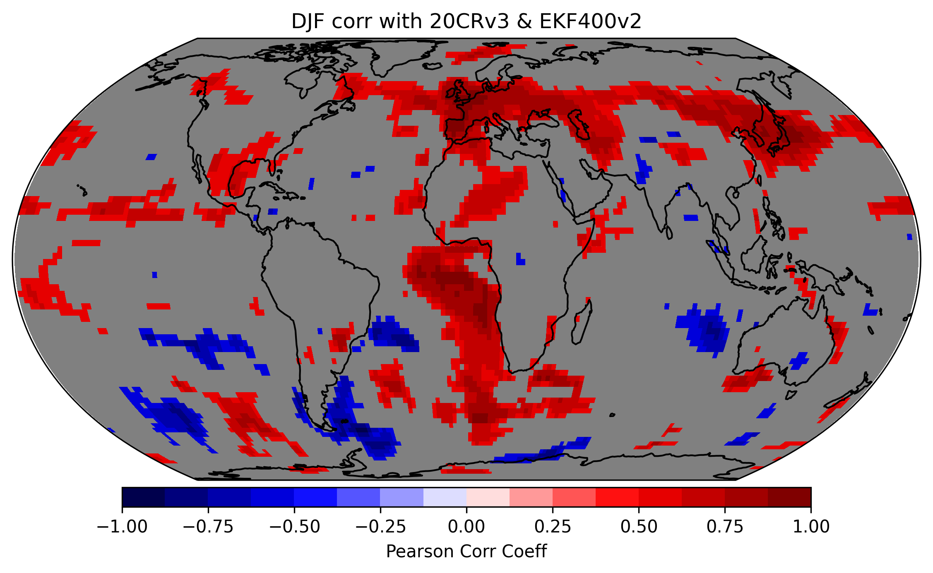
Correlation with 20CRv3 1836–1850 DJF

Slide 20
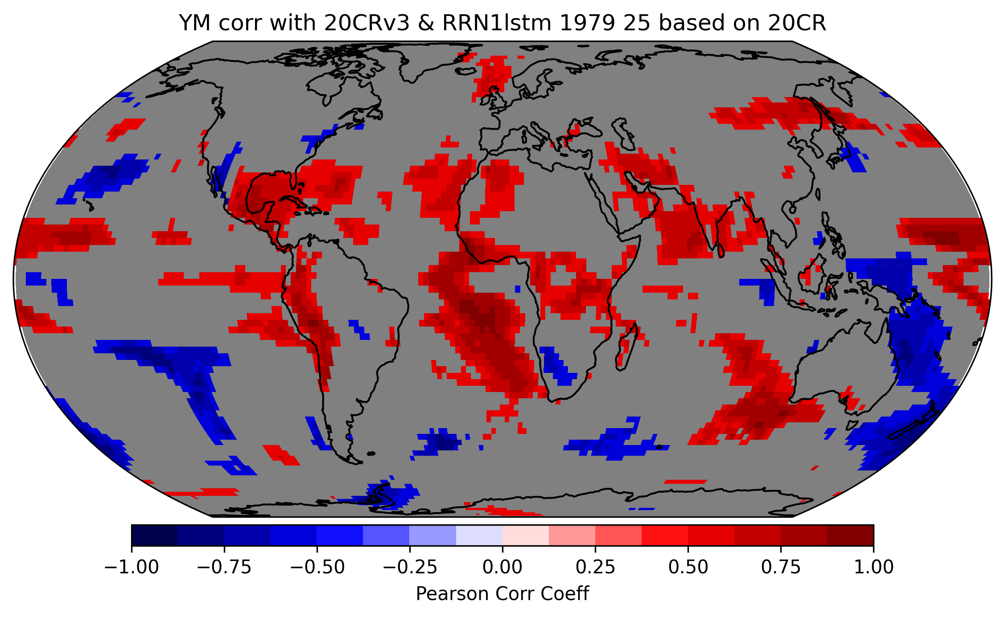
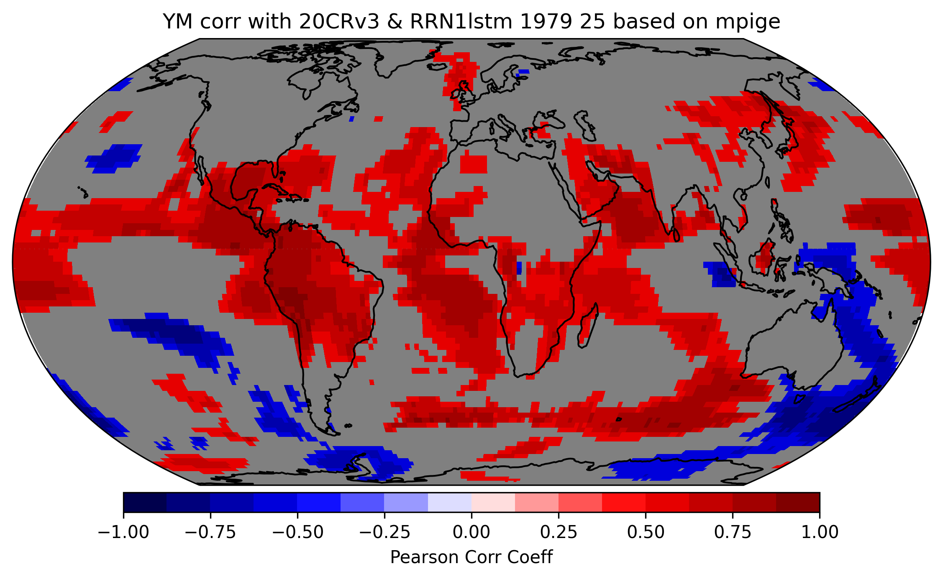
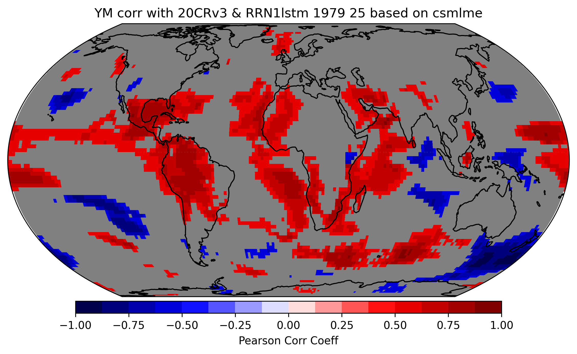
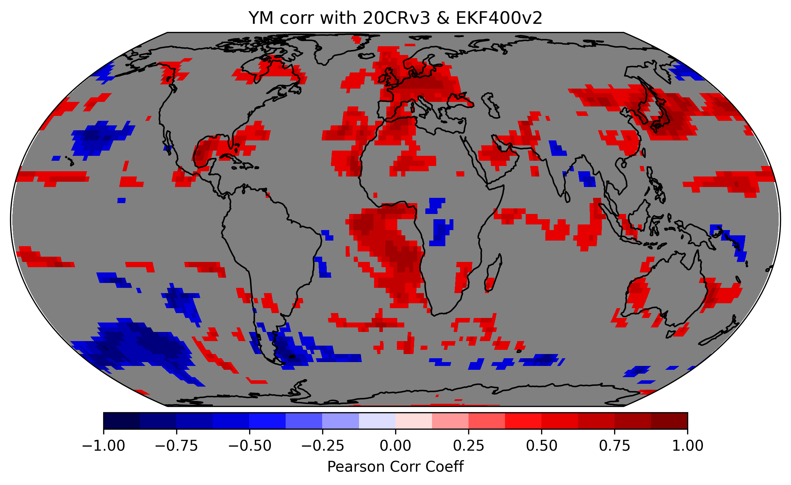
Correlation with 20CRv3 1836–1850 Yearly mean

Slide 21
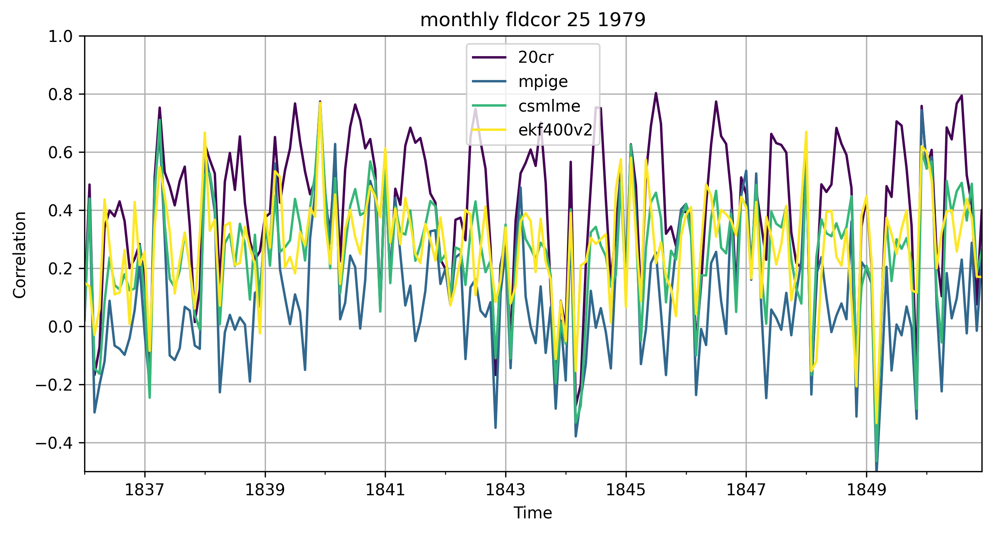
Correlation with 20CRv3 1836–1850 monthly

Slide 22
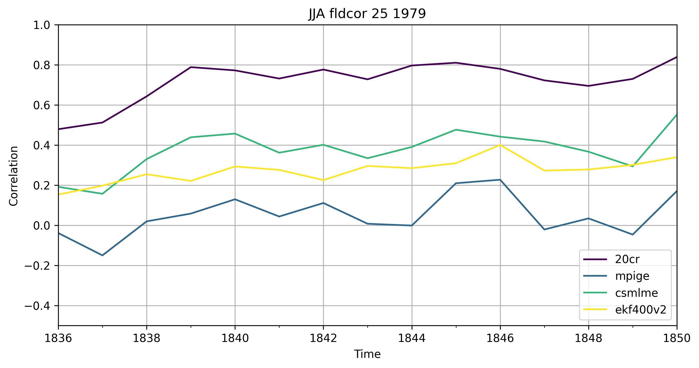
Correlation with 20CRv3 1836–1850 JJA

Slide 23
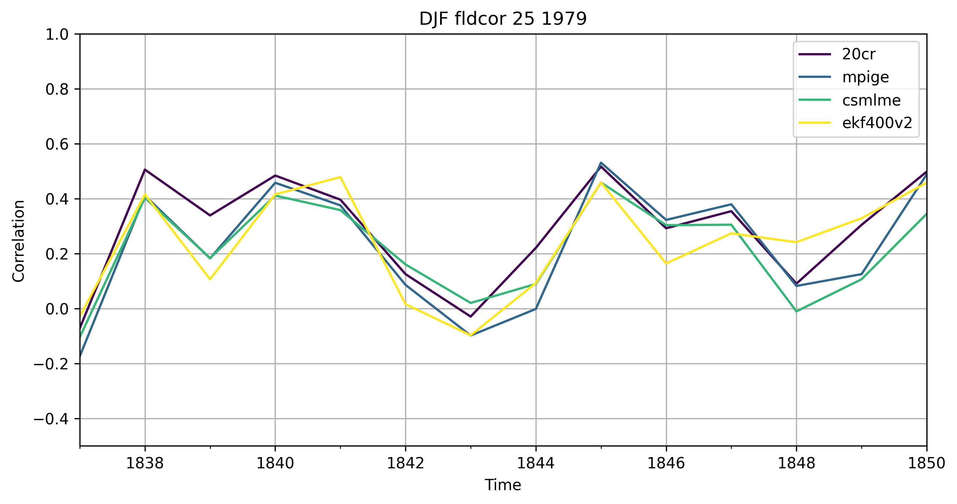
Correlation with 20CRv3 1836–1850 DJF

Slide 24
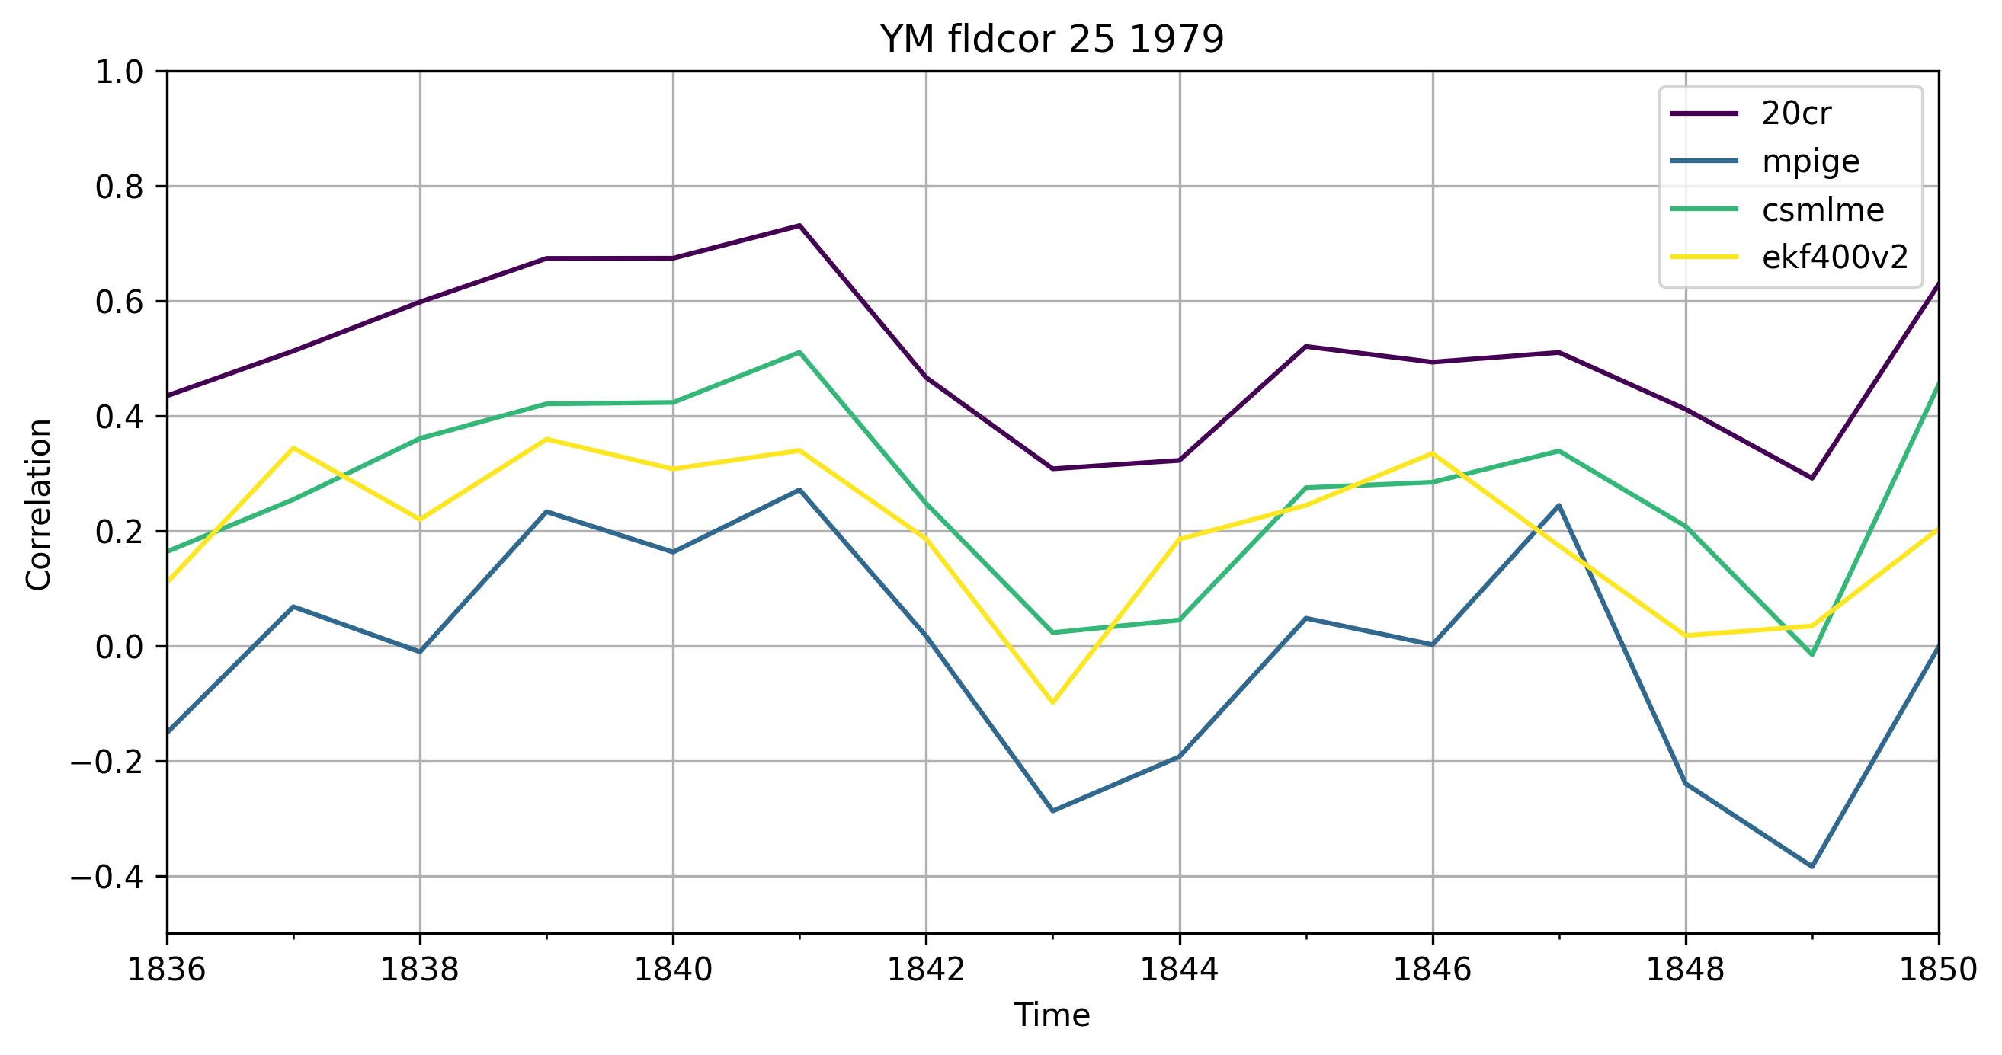
Correlation with 20CRv3 1836–1850 yearly mean

Slide 25
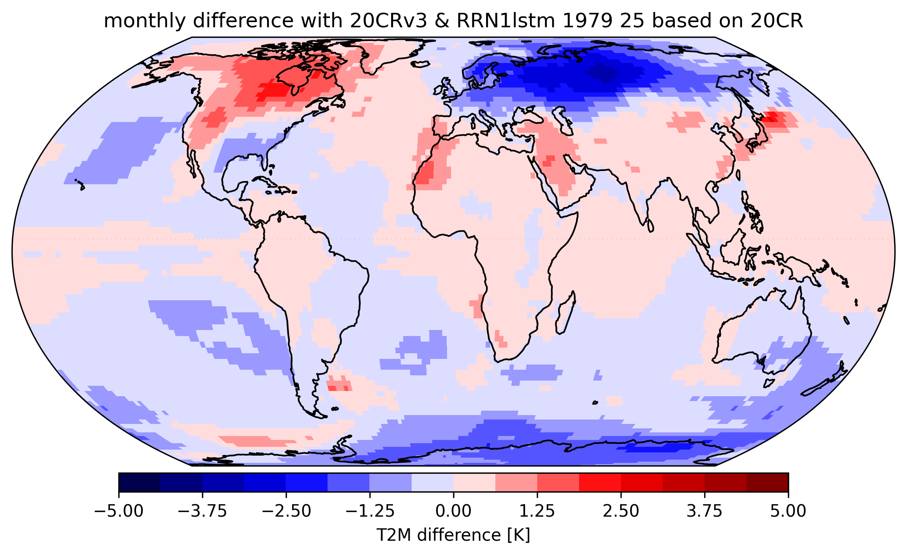
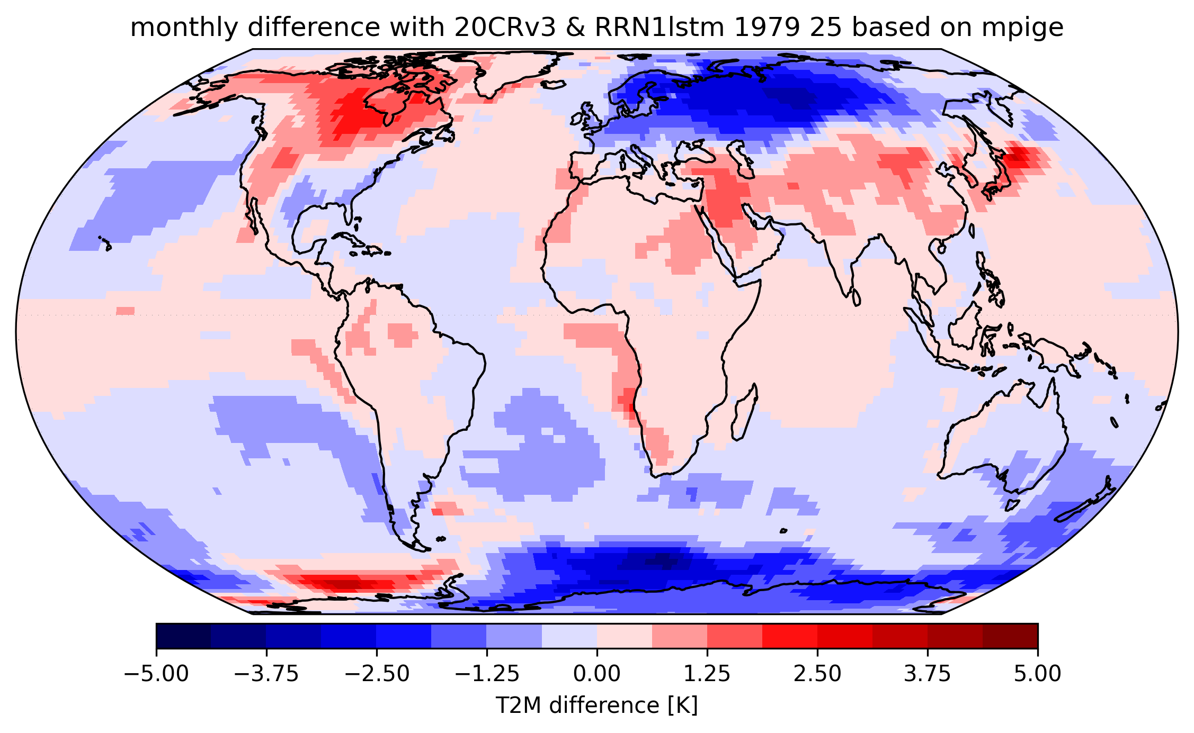
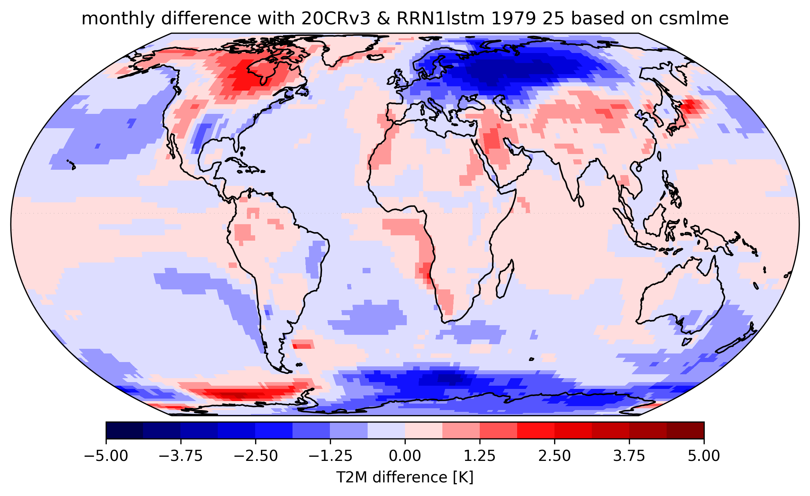
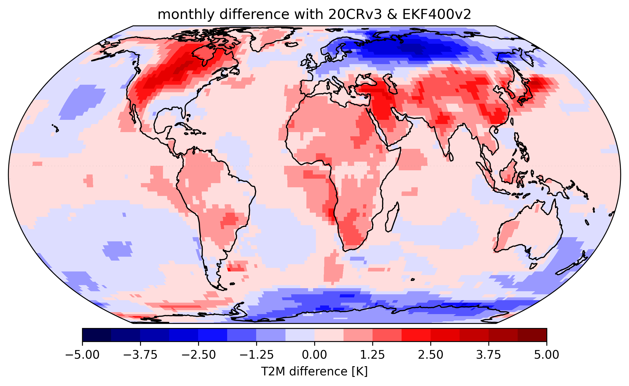
Difference with 20CRv3 1836–1850 monthly

Slide 26
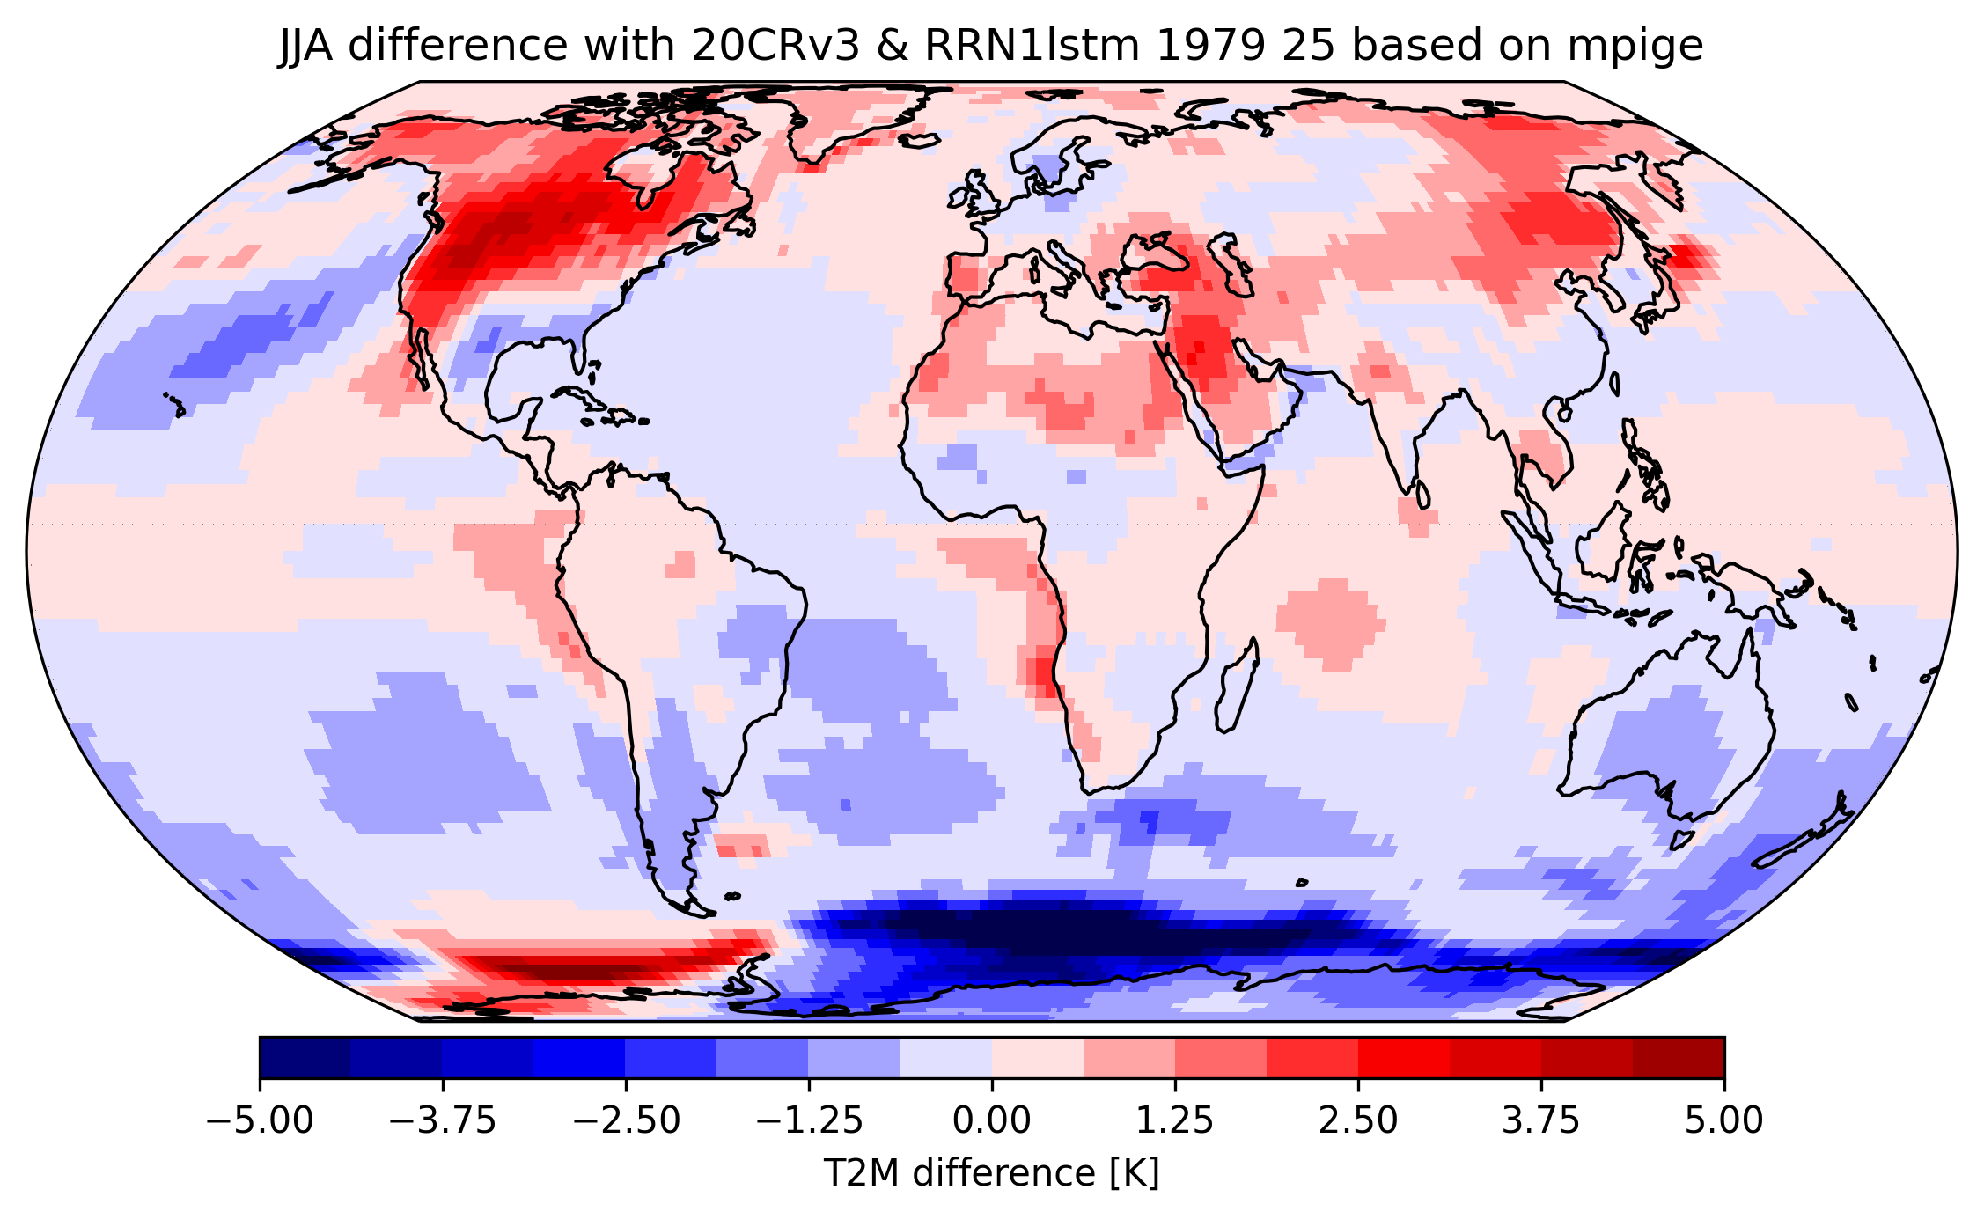
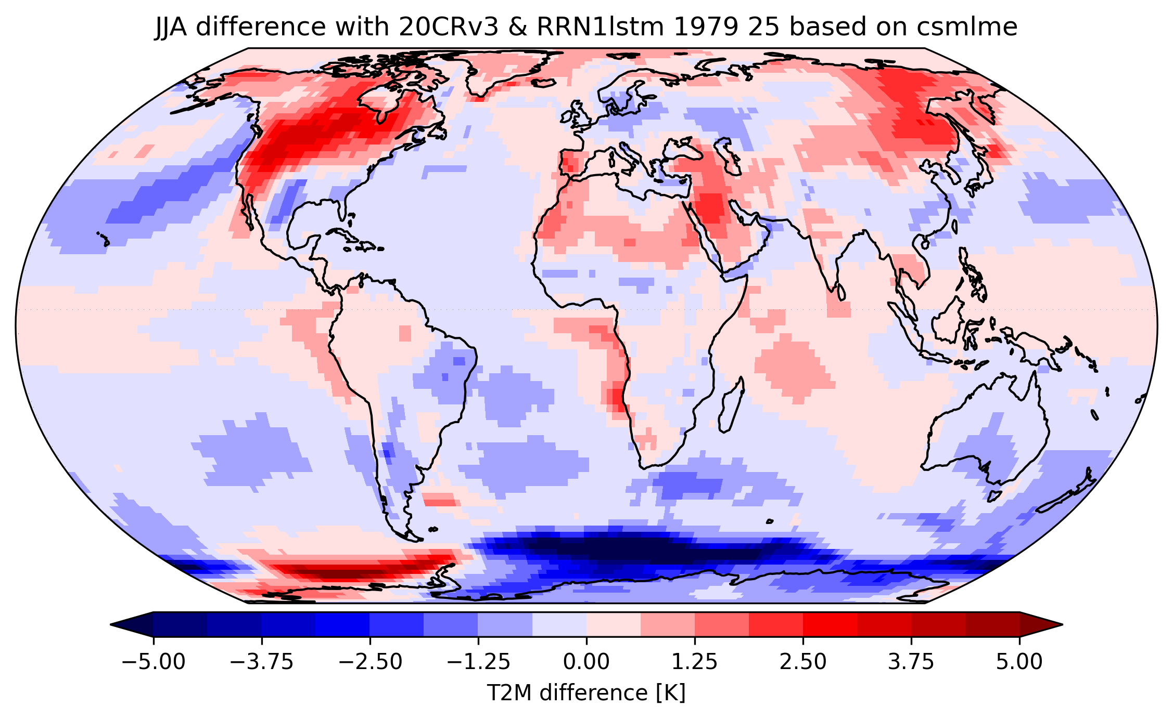

Difference with 20CRv3 1836–1850 JJA

Slide 27




Difference with 20CRv3 1836–1850 DJF

Slide 28




Difference with LMR 1836–1850 YM

Slide 29

Difference EFK400 with LMR 1602-2000 YM

